Slide 2
PICC Tip Location:
The Why Behind The Where
Systems Thinking: Minimizing PIV and CVC Injuries
Standardization With Respect for Complexity
Continual Iterative Monitoring and Training

Slide 3
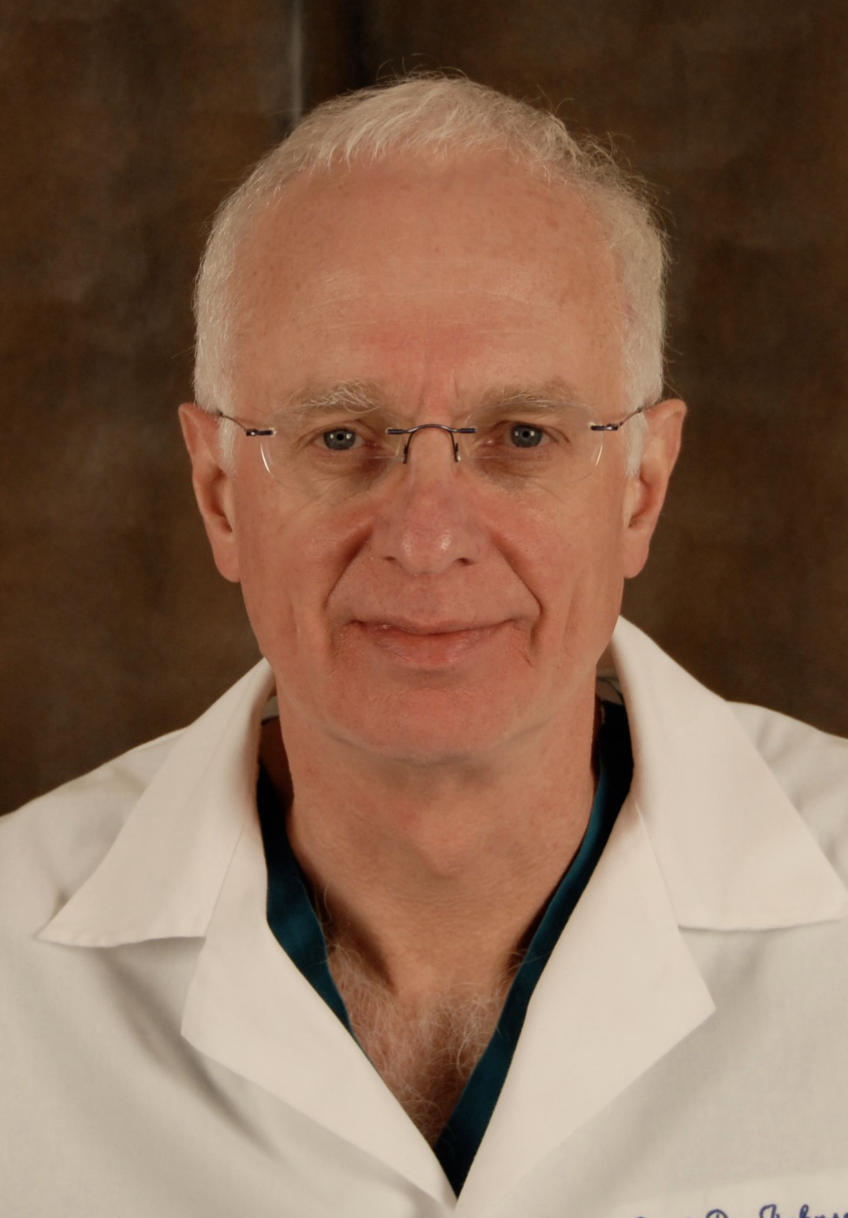


Neil Johnson MB.BS. M. Med. FRANZCR
Jamie Webb MSN, RNIV, Va-Bc
Disclosure of Relevant Financial Relationships​
We have no financial relationships to disclose.​
​
Disclosure of Off-Label and/or investigative Uses​
​
We will not discuss off label use and/or investigational use in our presentation.​

Slide 4

Understanding Implicit Bias
Attitudes that are unconscious and unintentional
Implicit bias refers to unconscious attitudes, beliefs, stereotypes, or prejudices that individuals may hold towards certain groups or individuals based on characteristics such as race, gender, age, or socioeconomic status. These biases are often unintentional and can influence our perceptions, decisions, and behaviors, even when we may consciously strive to be fair and impartial.
May be deeply Ingrained and Subconscious
Implicit biases are formed through societal, cultural, and personal experiences, as well as the influence of media and upbringing. They can be deeply ingrained and operate at a subconscious level, impacting our interactions and decision-making processes.
Bargaining Power Of Buyers
What sets implicit biases apart from explicit biases is that individuals may not be consciously aware of holding them. These biases can persist despite an individual's genuinely held commitment to equality and fairness.
CA 241
Self-reflect your views
Recognizing and addressing implicit biases is crucial in promoting inclusivity, fairness, and equity in various domains, including healthcare, education, and employment. It is important to engage in self-reflection, education, and dialogue to identify and challenge our implicit biases, as this can help foster more equitable treatment and decision-making.
Stride towards a more inclusive and equitable state
It's important to note that implicit biases can be countered through conscious efforts, such as increasing awareness, providing diverse perspectives, implementing unbiased policies and practices, and fostering empathy and understanding. By actively addressing implicit biases, we can strive towards a more inclusive and equitable society.
Notes:
CA 241 bill requires speaker to educate the audience and themselves about implicit bias

Slide 5
Outline:
The “WHY”
High Risk Infusates Rapidly Diluted by HIGH VENOUS FLOW
Cincinnati Stratification of High – Medium – Lower Risk (RYG) Medications – update
The “WHERE”
HIGHEST Risk (R) Drugs Administered into HIGHEST Venous Flow
HIGHEST Venous FLOW is Superior or Inferior CAV0-ATRIAL Junction
(All) Central Lines: The Cincinnati Tip Position Standards (Normal Anatomy Patients)
Upper Limb PICC
Lower Limb PICC
Role of Radiology and New Non-Radiology Devices
Unintended Arterial PICC’s – Impending Disaster
Other Misbehaving PICCs
NICU: “Abolition” of Pericardial Tamponade – Its Possible
Our Basic Team Operations

Slide 6
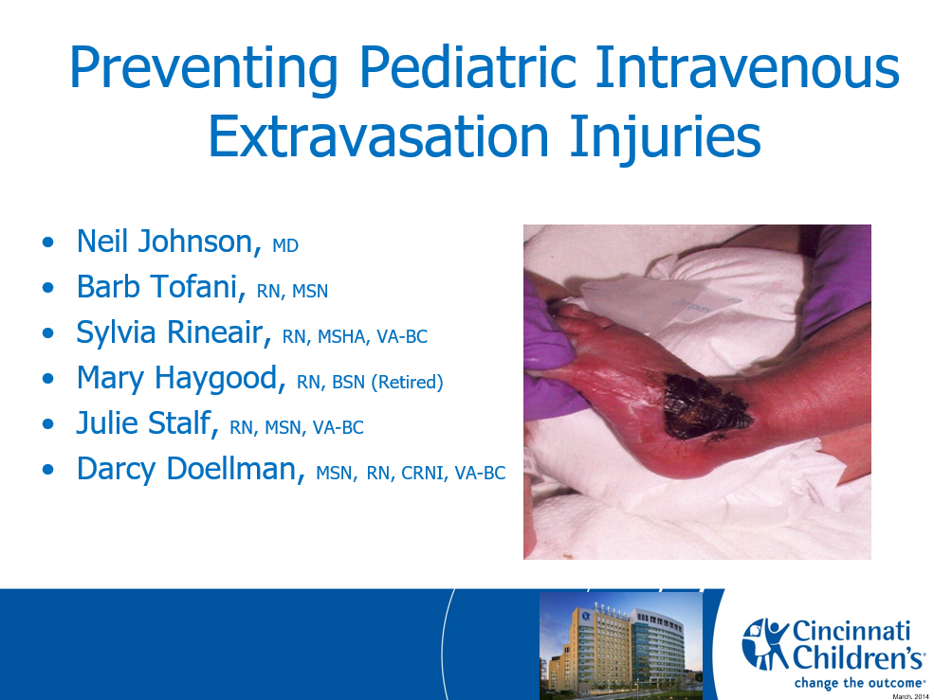
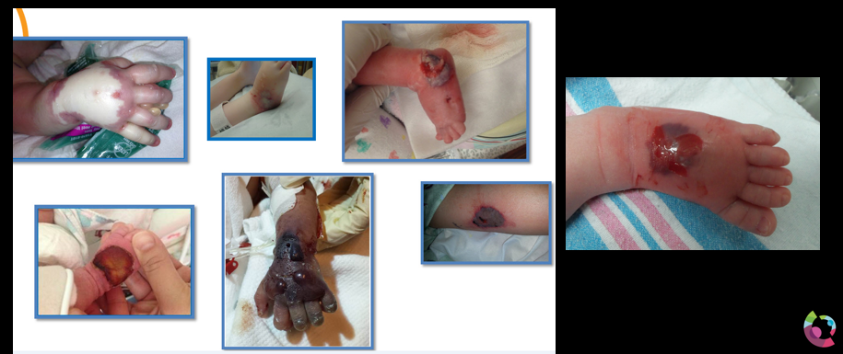
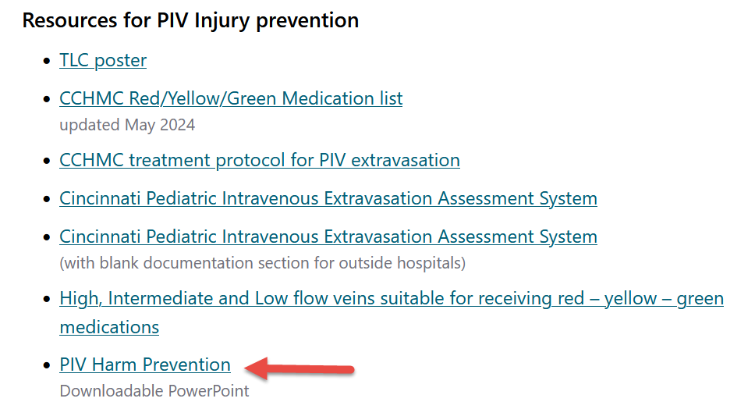

2009 …Unacceptable Injuries
This Started our Vascular Safety Journey
  Multiple serious PIV Injuries
Stopivharm.org
2010
Nationally Ranked Pediatric Hospital (Not CCHMC)
CCHMC

Slide 7
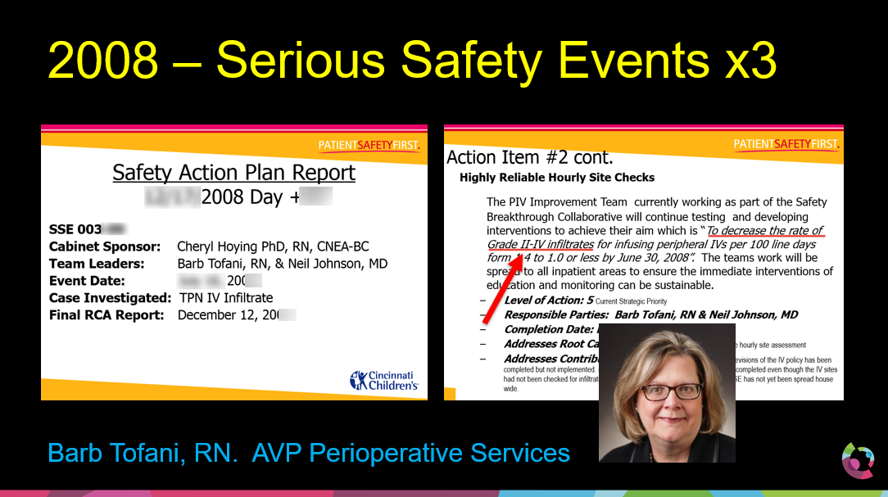
2009 PIV Safety / Improvement Work

Slide 8
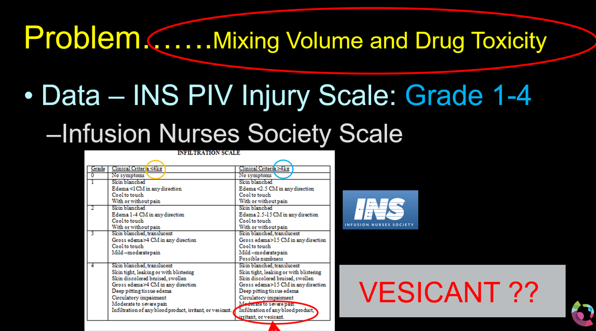
The INS PIV Grading Scale

Slide 9
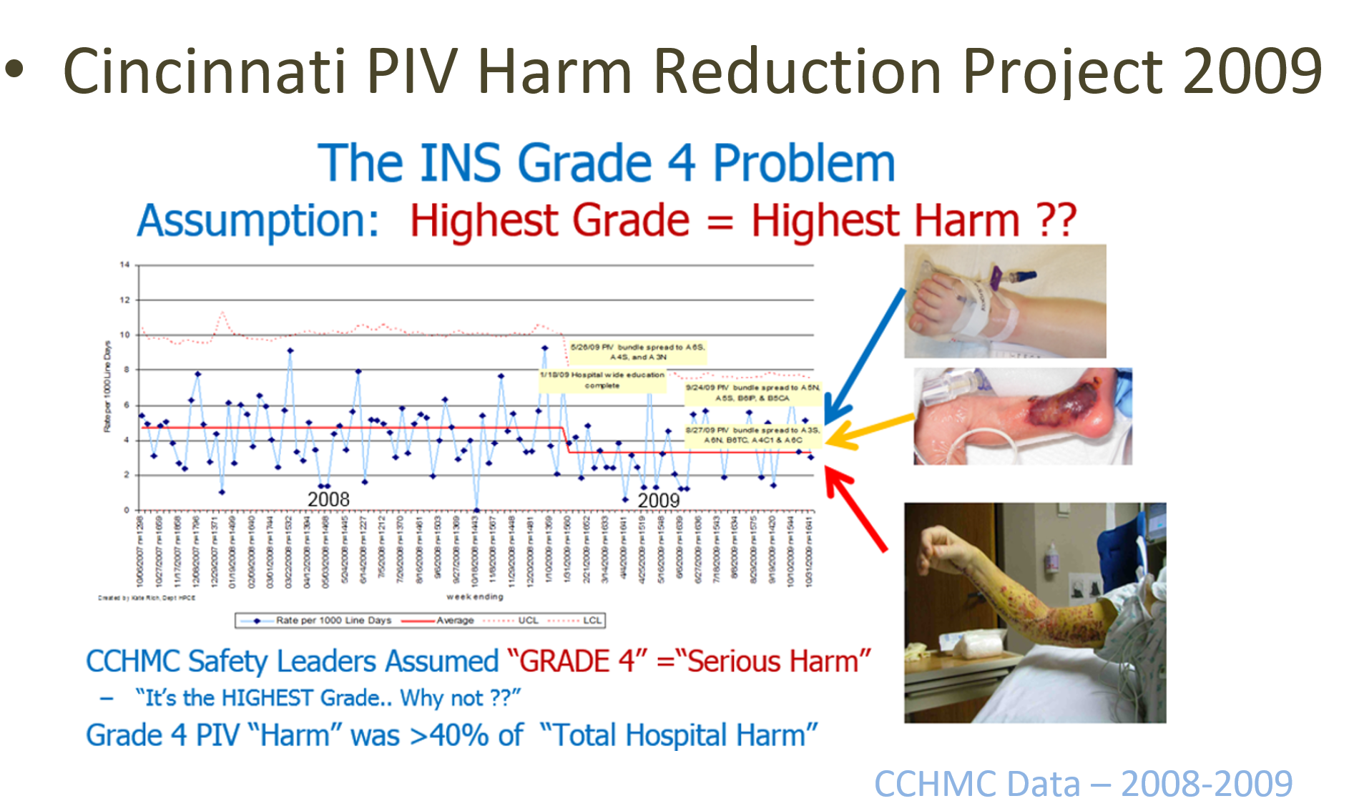
The Safety Improvement “Problem”

Slide 10
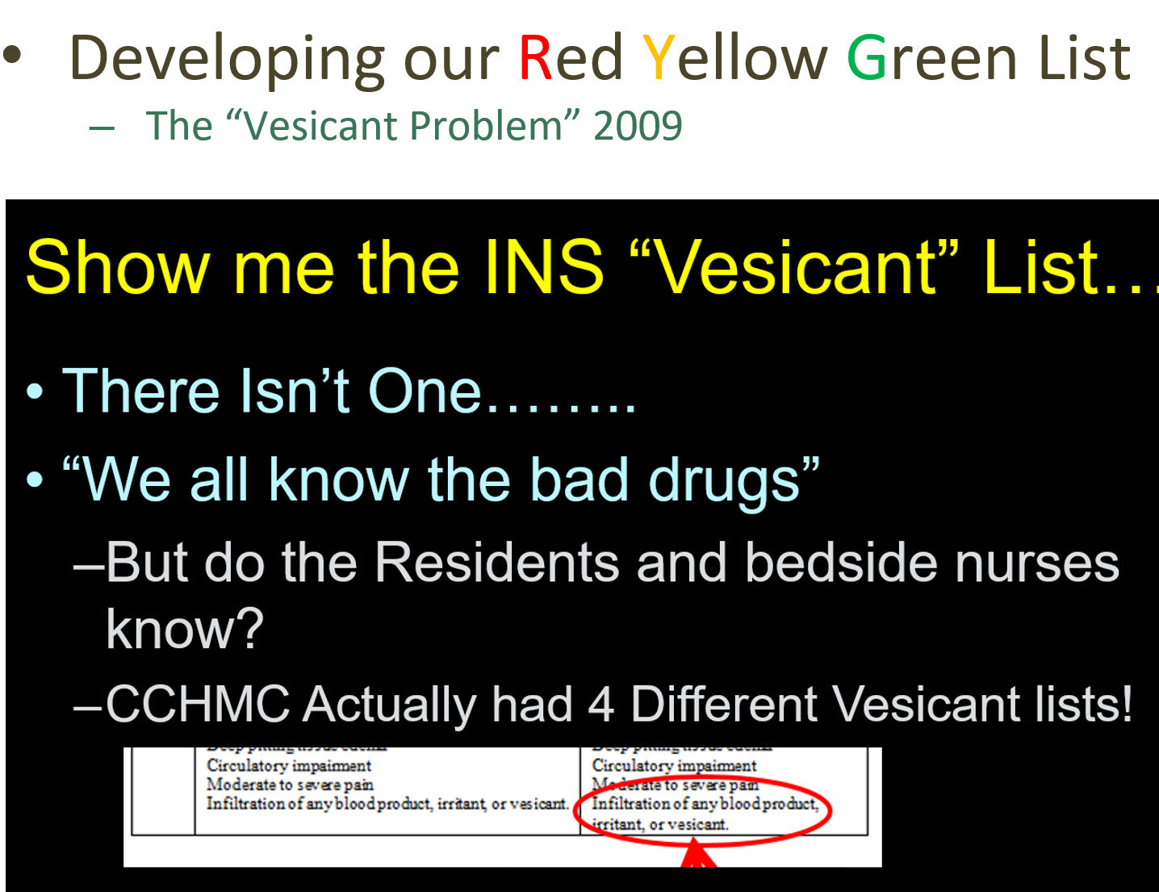

Slide 11
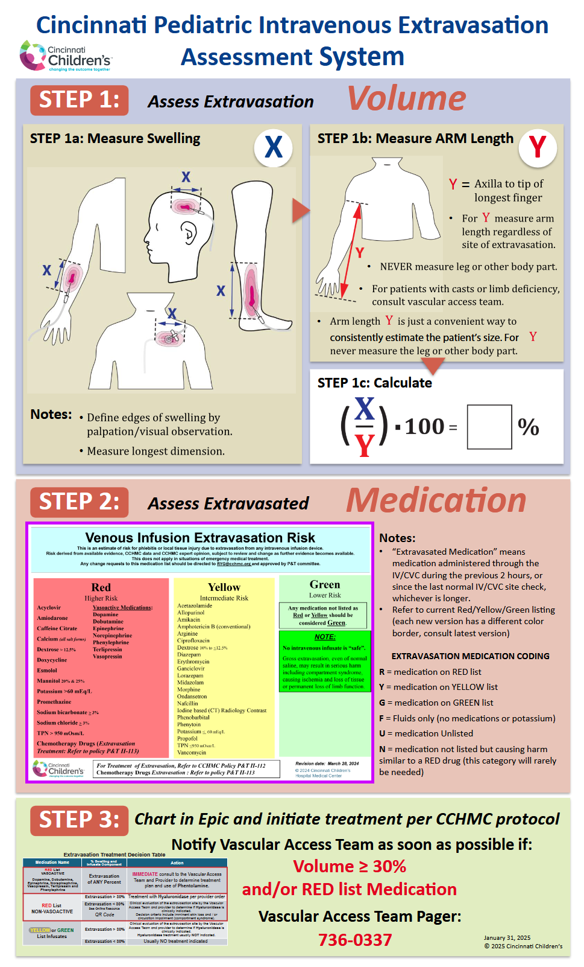
So……We….
Abandoned the INS “Grading System”
Started with Blank Sheet Redesign
Separated the Two Major PIV Injury Components
  VOLUME
  “BAD” Drugs and Infusates
Developed an Evidence Based “Bad Drug” List (RYG)
Removed Descriptive Terms
Created a NUMERIC Assessment of Extravasation Volume (%)
SIMPLIFIED the TERMINOLOGY
  “Vesicant” Replaced with (RYG)Terminology
  Abandoned “Infiltrate” Vs “Extravasation” Replaced with ONLY “Extravasation”
Educated and Spread Institution-Wide
EXTRA = “Out Of” VASA = “Vessel” …… ExtraVasation = Stuff Outside the Vessel

Slide 12
Simplify
Simplify
Simplify
Educate
Spread
Monitor and Revise
All CCHMC Posters / Materials available for Non-Commercial Use:
CCHMC Website (good luck)
https://stopivharm.org

Slide 13
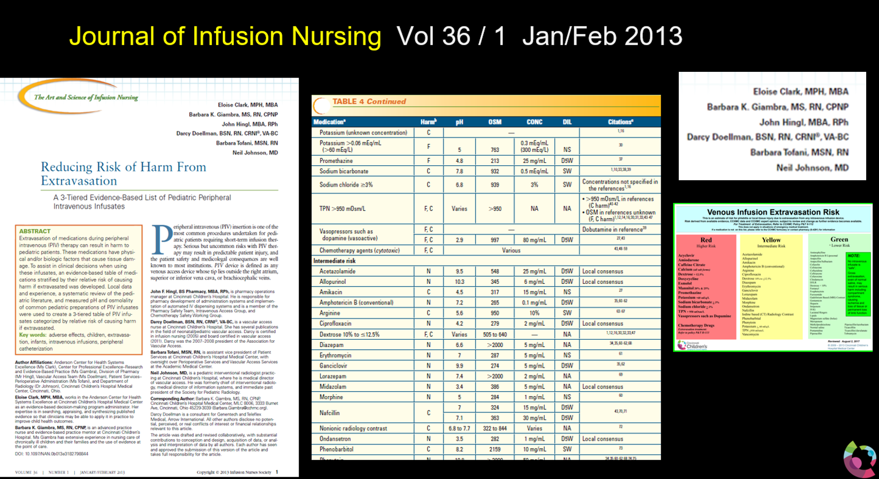
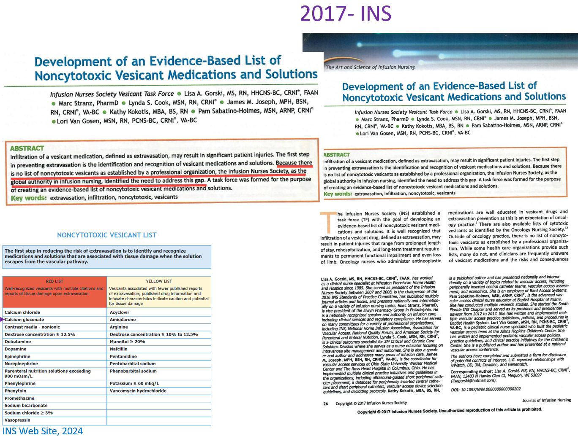
The Cincinnati “Bad Drug” List The INS List
Measured pH and Osmolarity of COMMON DILUTIONS
Published 2013
Published 2017
RED Drugs:
- pH >9 or <5 (In Common Dilutions)
- Vasoactive Drugs
- Osmolarity > 950 mOsm
- Strong Literature Evidence

Slide 14
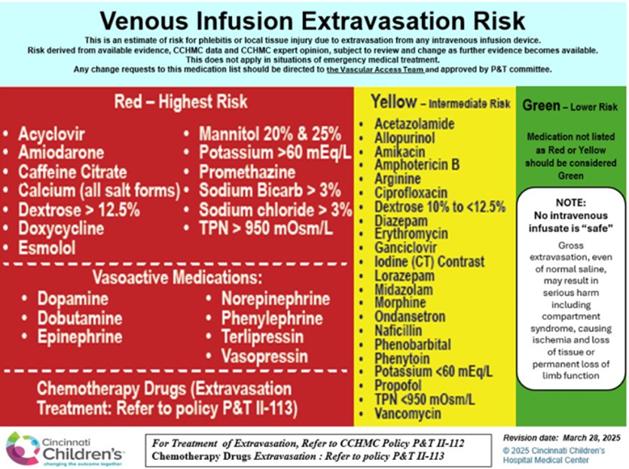
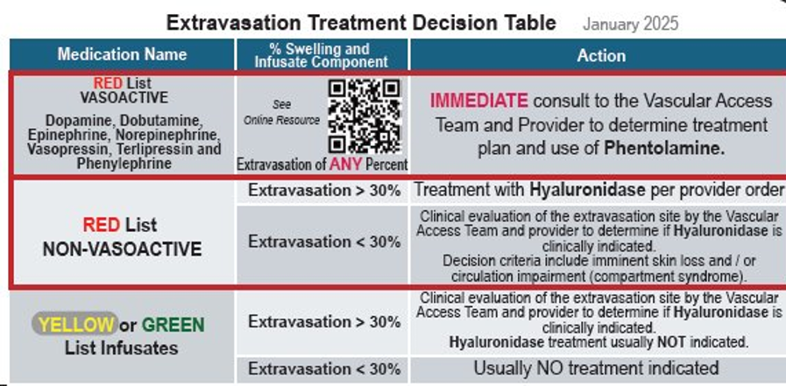
RN / MD Badge Cards

Slide 15
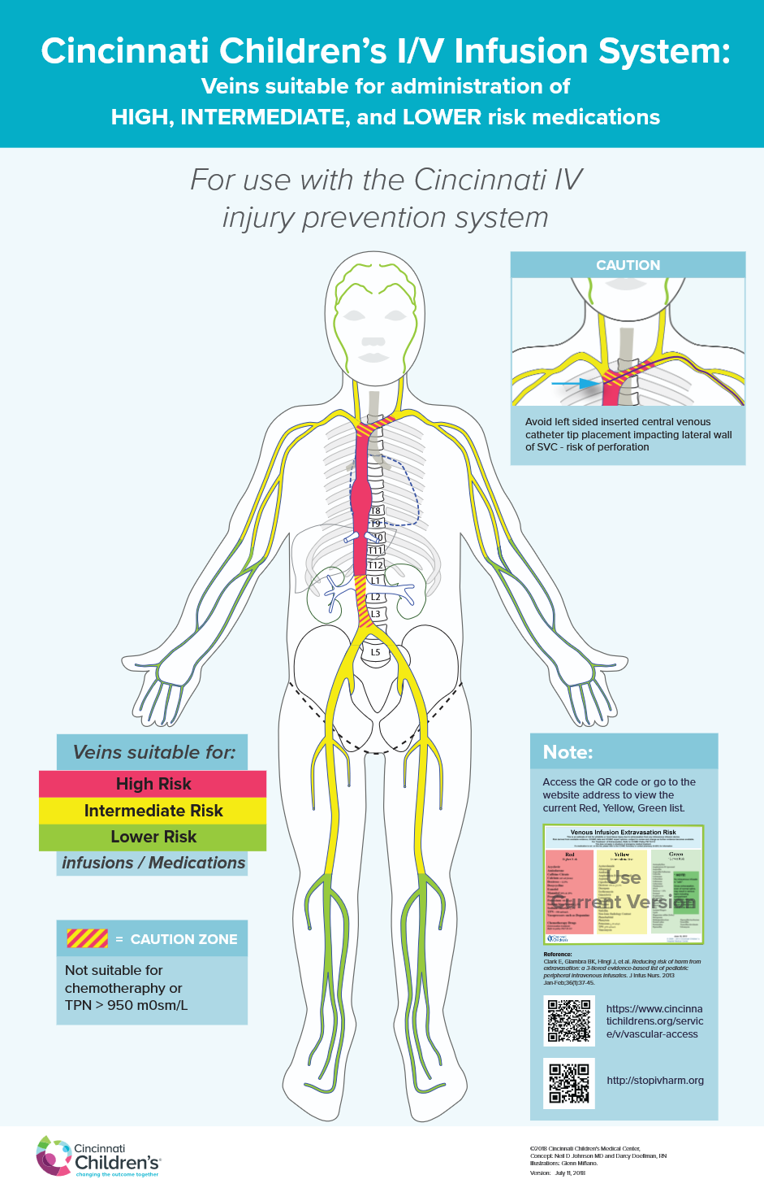
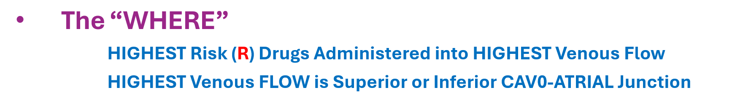
So…. We Created a RYG …VEIN Diagram
Based of VENOUS FLOW
Because High FLOW …
  Rapidly Dilutes BAD Drugs
  Reduces Injury to the Endothelium
RED Drugs → PICC Tip in RED Vein
Yellow Drugs → PICC Tip in Yellow (or Red) Vein
Green Drugs → PICC Tip in Green (or Red/ Yellow) Vein
      There ARE Exceptions….

Slide 16
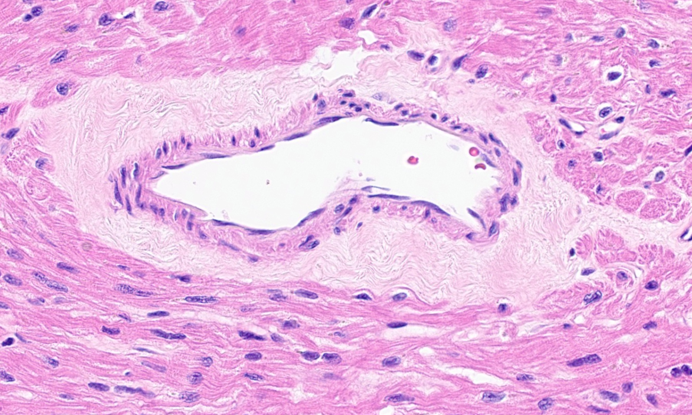
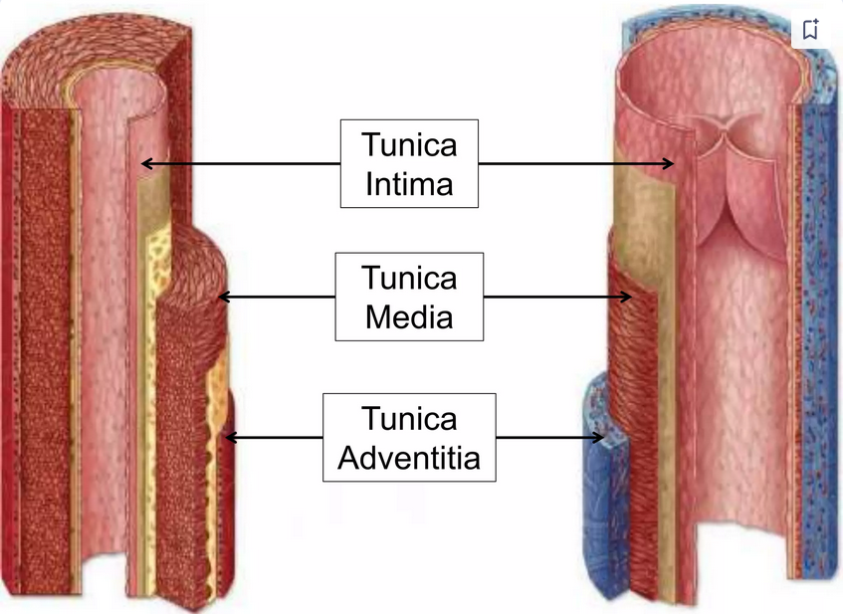
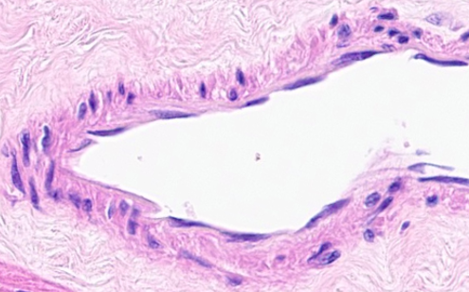
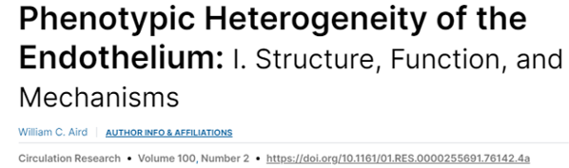
Why are Bad Drugs “Bad”? …It’s the Endothelium
Venous Anatomy
Adventita
Media
“Endothelium”
Endothelial Cells
https://www.slideshare.net/slideshow/histology-of-blood-vessels/187047892
Courtesy Dr Sara Szabo, Cincinnati Children's Hospital 7/2024

Slide 17
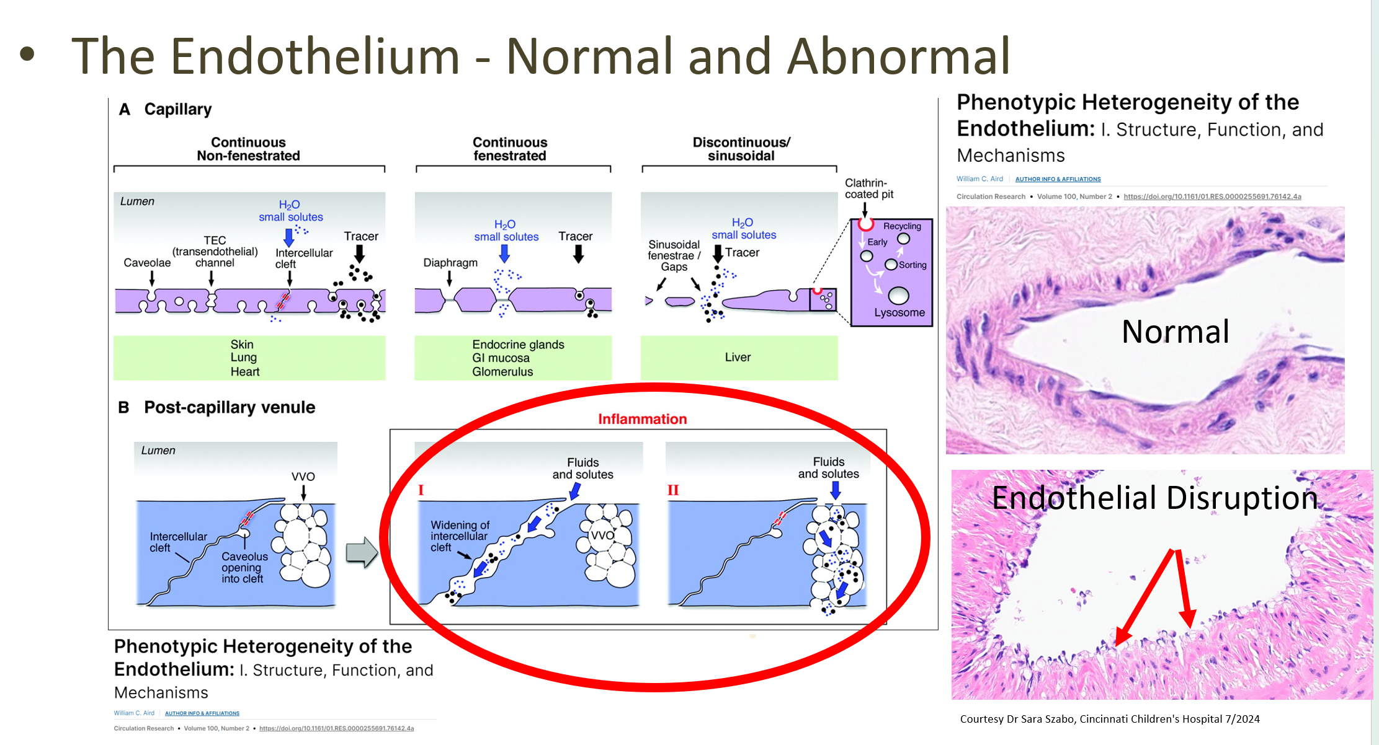
If Endothelium is Damaged….Bad Things Happen
RED Drugs

Slide 18
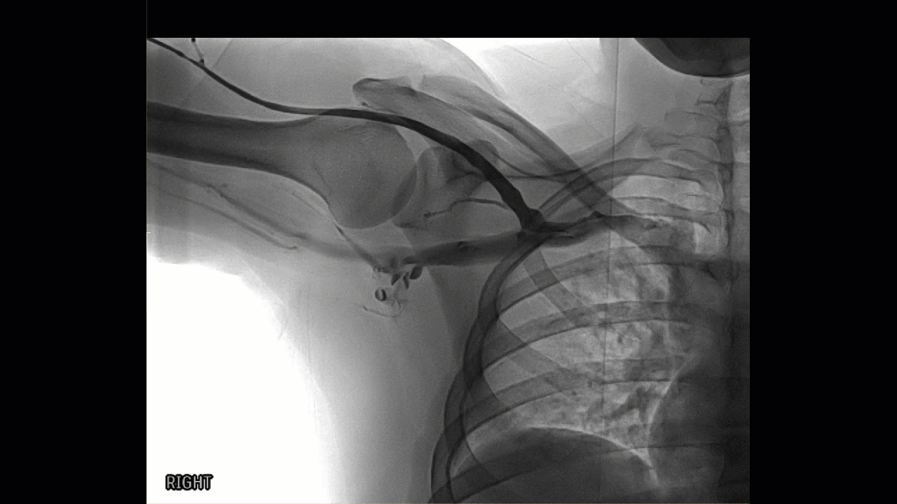
Fast Flow:
Dilutes Red Drugs and Protects Endothelium

Slide 19
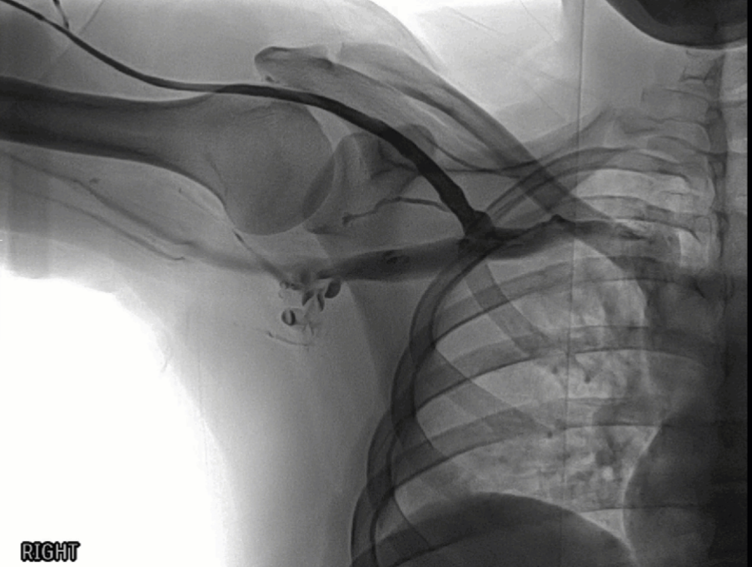
Flow…
Right Arm Venogram
Cephalic Vein
Slow Flow Cephalic Vein
Faster Flow Subclavian Vein
BUT..
VERY Fast Flow → SVC
RT Jug
S
V
C
Subclavian Vein
Axillary Vein
SVC
SubClavian Vein: Outer Border 1st Rib – Jugular Junction

Slide 20

Venous Flow
ChatGPT

Slide 21
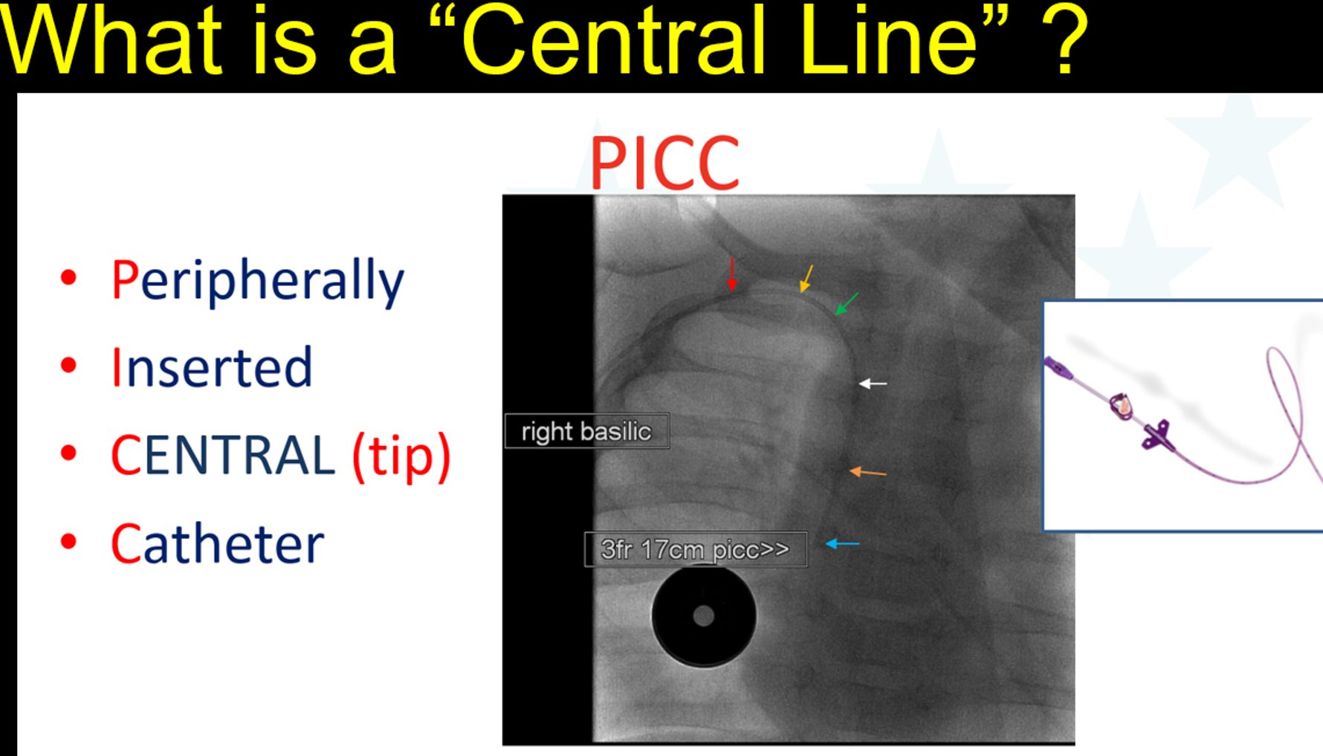
The “Central” Problem… Its NOT Black and white
Is There A Widely Accepted Definition of Central ?????
  CDC – CLABSI Definition
  “In the Chest”
  In a “Great Vein”
  “The Cincinnati Triangle”
  SVC
Instead of “Central” Vs “Non-Central”
We Now Encourage
FLOW Based Decision Making
MEDICATION Based Decision Making

Slide 22
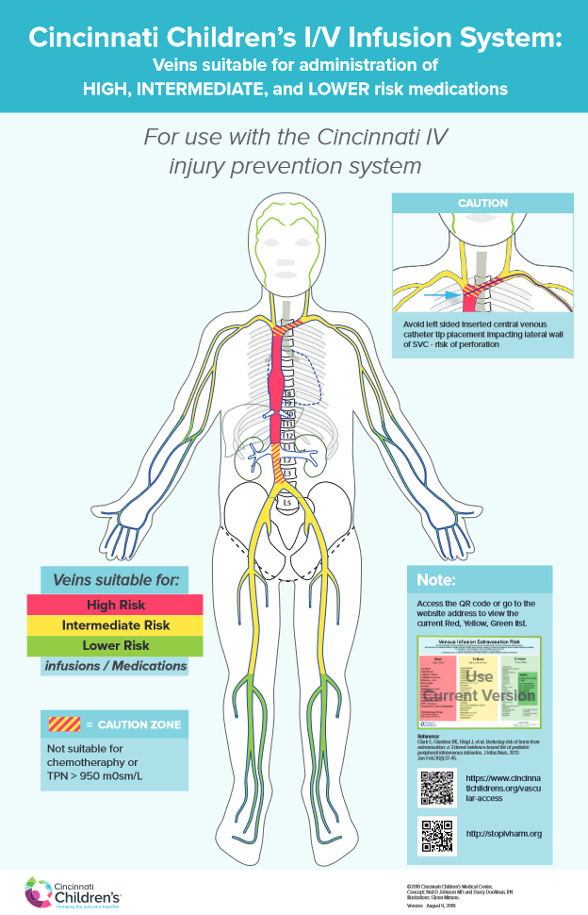
Flow Based Decision Making …
Replacing “CENTRAL” with "FLOW"
July 1 Questions to Radiologists:
  Is it CENTRAL?
  Is It SAFE to Use ?
Depends…
  Medications Intended
  Duration
  Other Issues
PICC tip in Brachiocephalic Vein
  2 Days of ABX and Fluids Remaining → OK
  6 Weeks of 1030 mOsm TPN → NOT OK
https://stopivharm.org

Slide 23
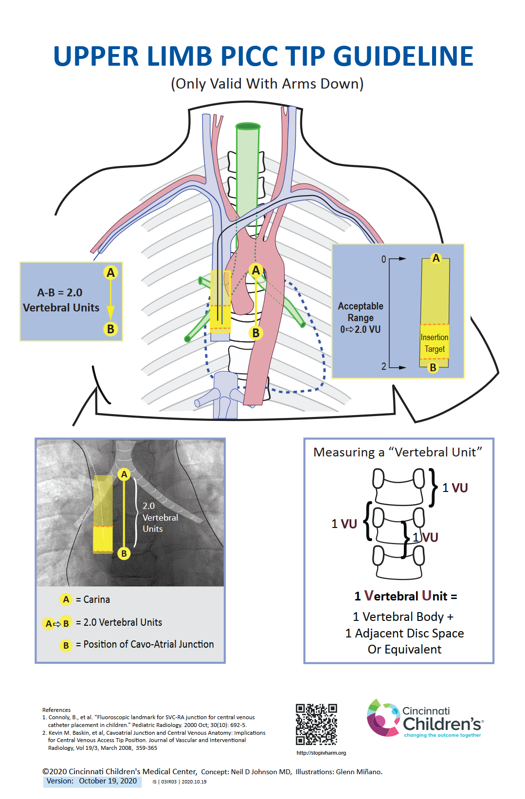
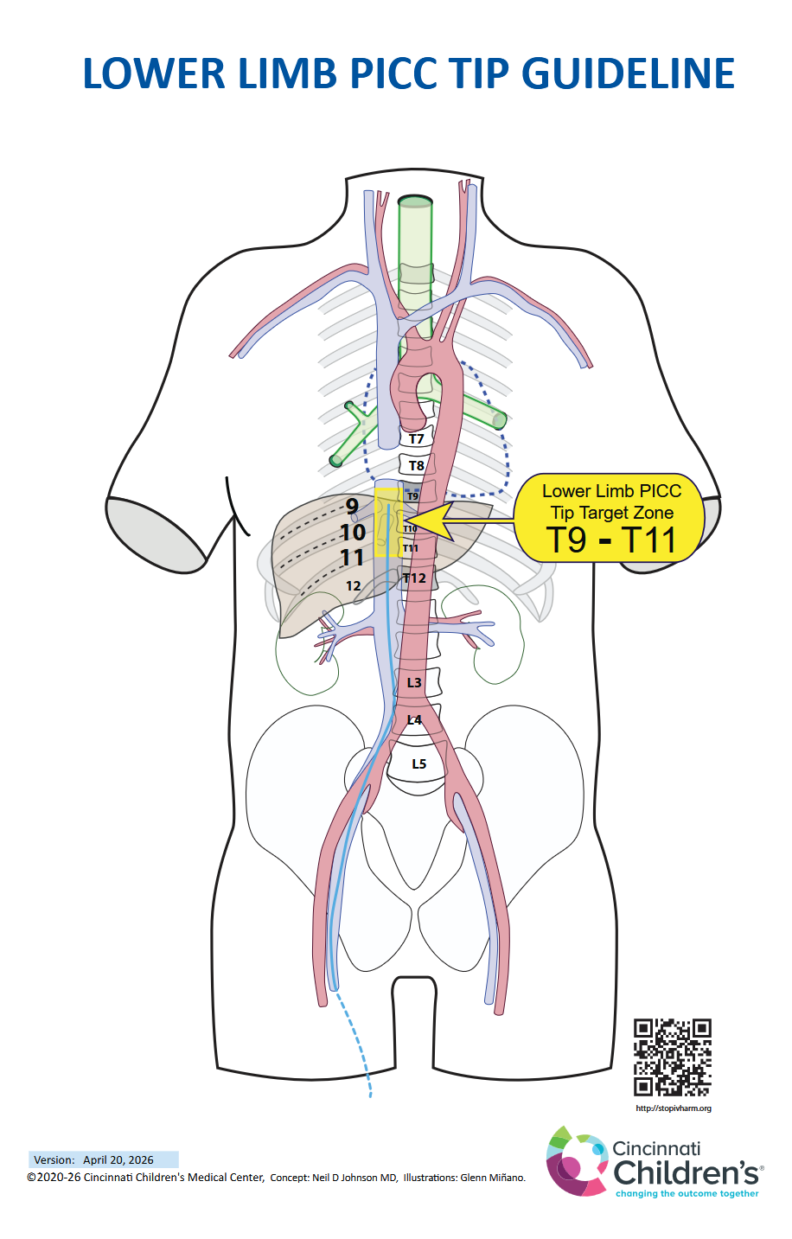
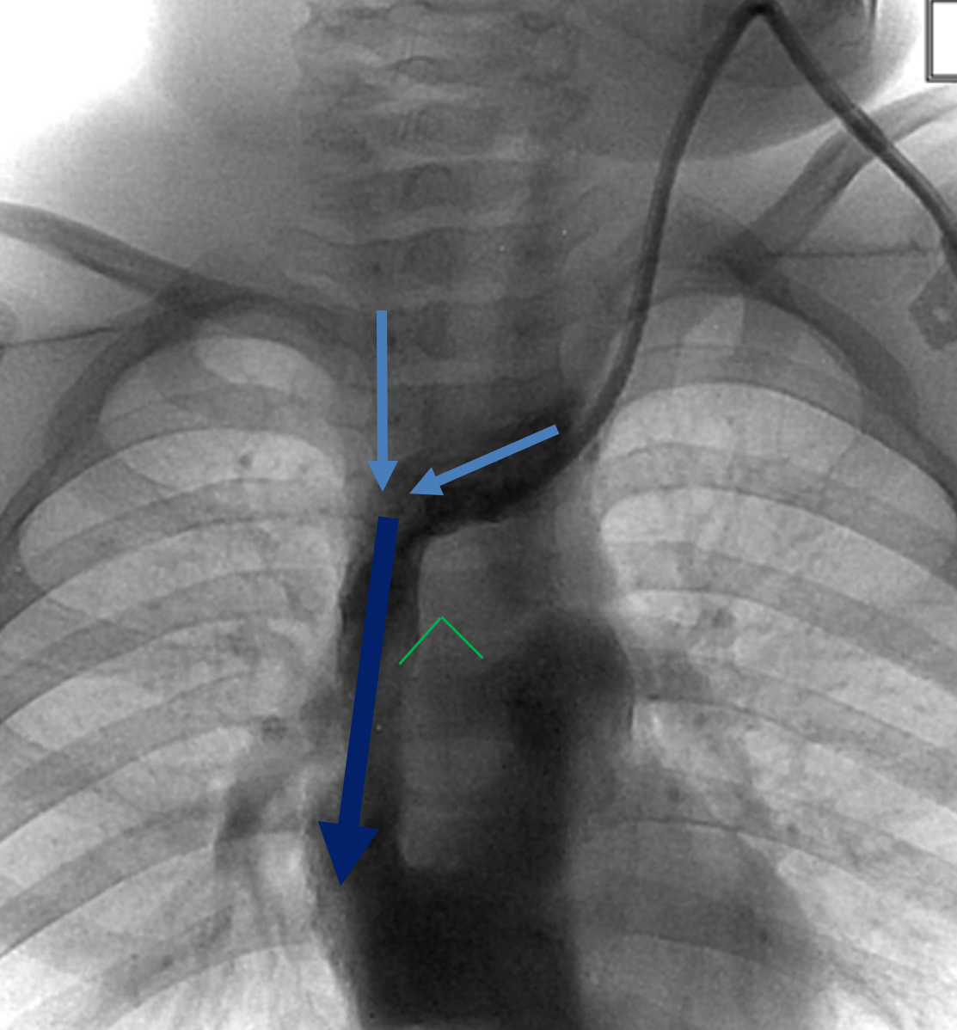
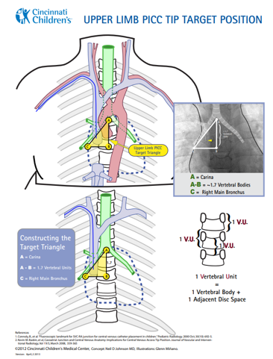
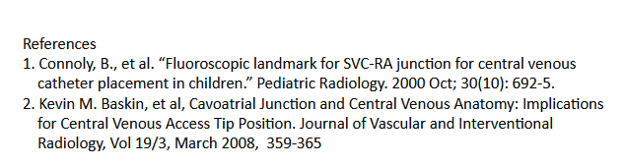
CCHMC PICC Tip Standards (Normal Patients)
No Triangles!
Stopivharm.org

Slide 24
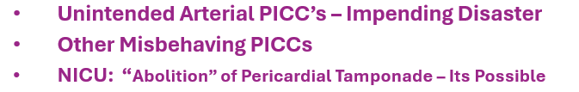
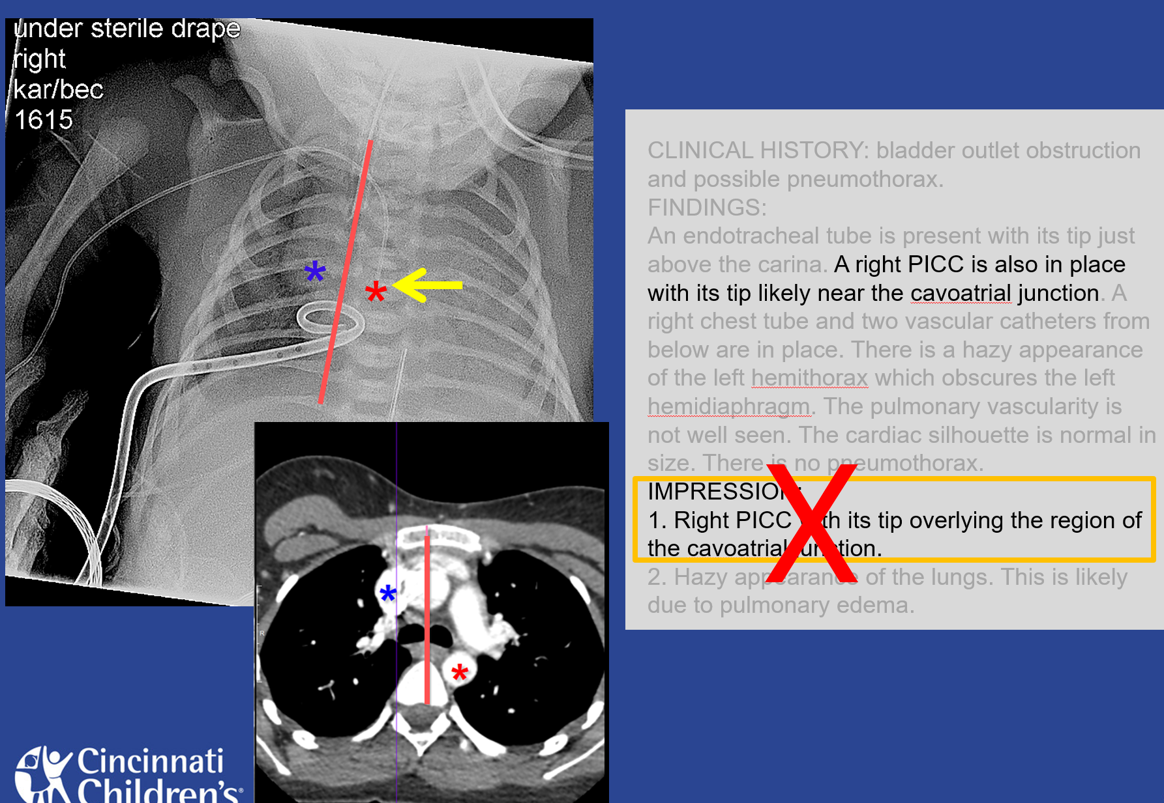
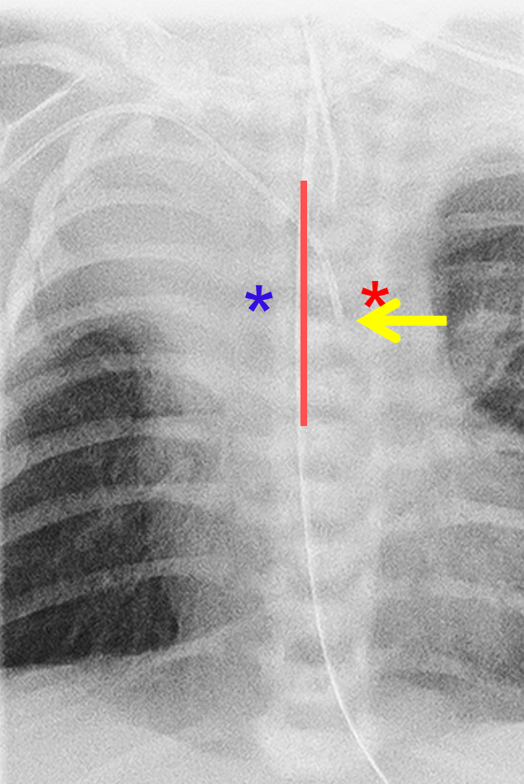
PICC Disasters Arterial PICC

Slide 25
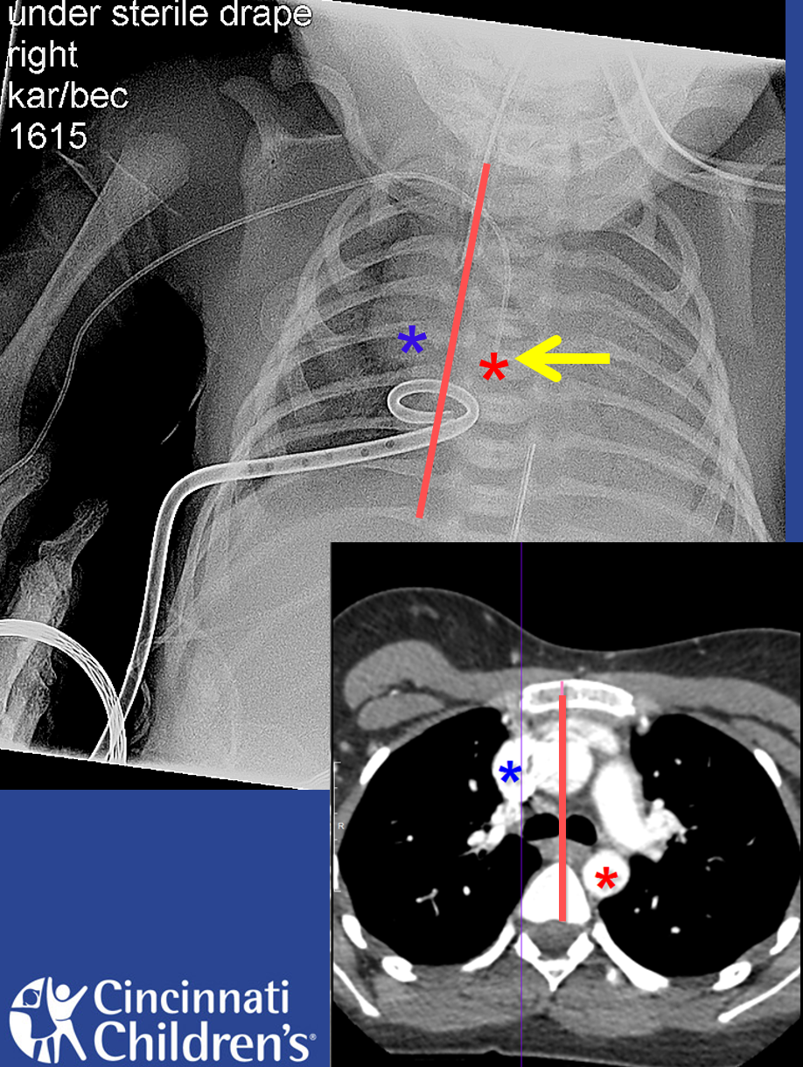
Any PICC To LEFT of Midline Structures
MUST Be Investigated Promptly
Possibilities:
  Descending Aorta
  Left SVC
  Situs Inversus
  Congenital Cardiac Defects
Normal Desc Aorta is LEFT of Midline Structures
NO amount of CXR Rotation will Change That
Midline Clues:
ETT
NG Tube ( esophagus)
Trachea / Carina

Slide 26
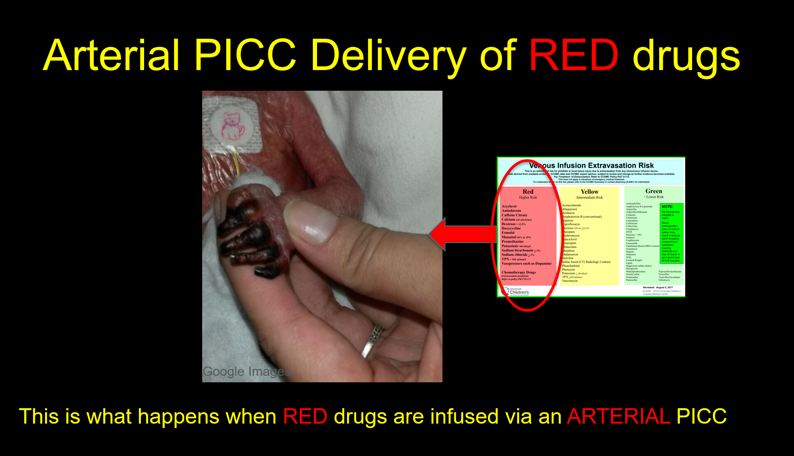

Slide 27
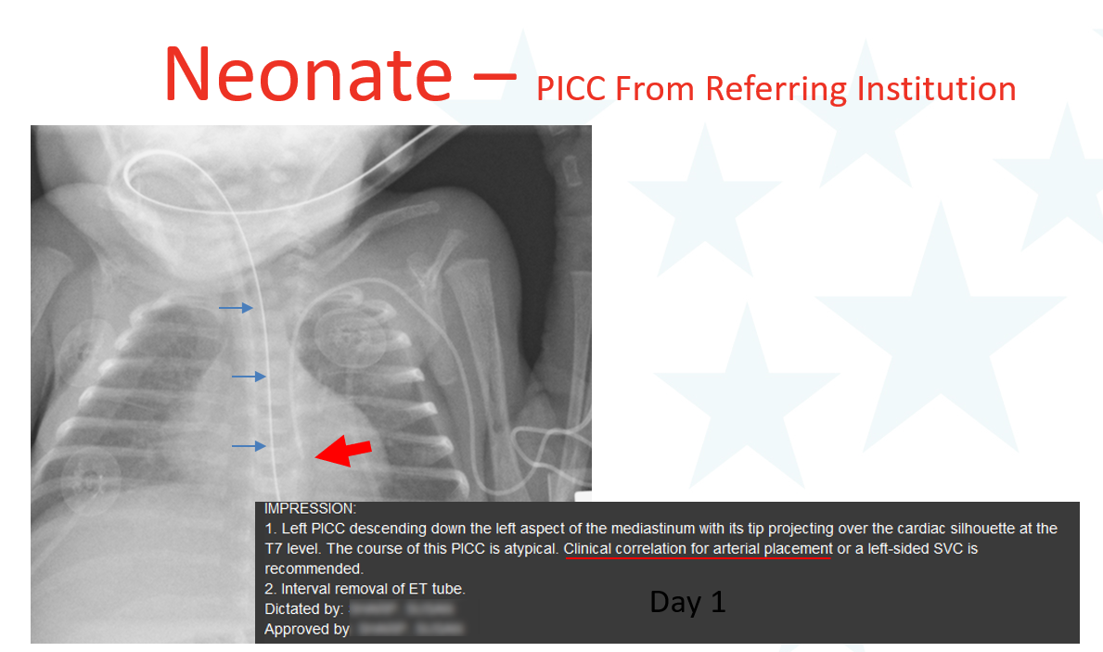
Arterial PICC Case

Slide 28
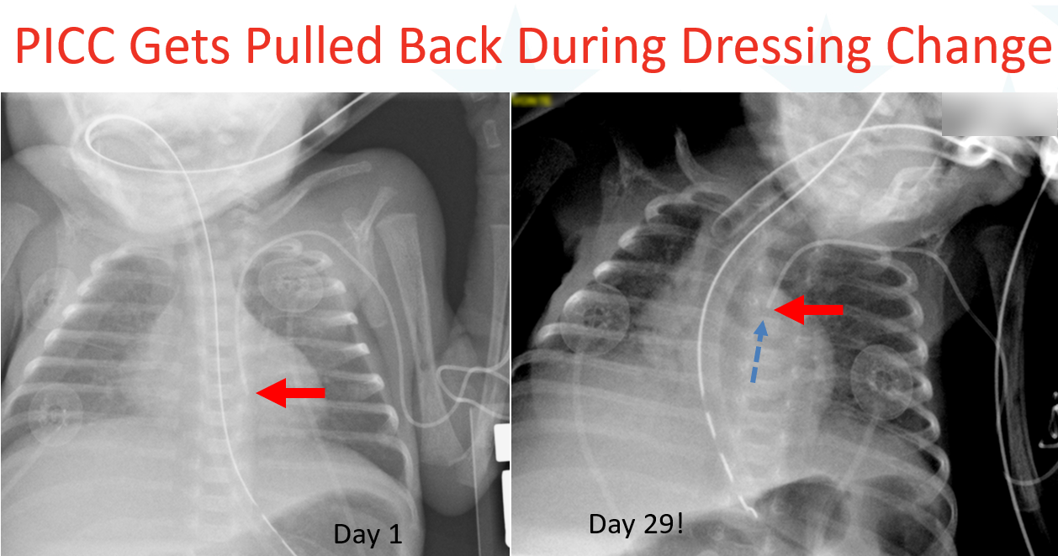

Slide 29
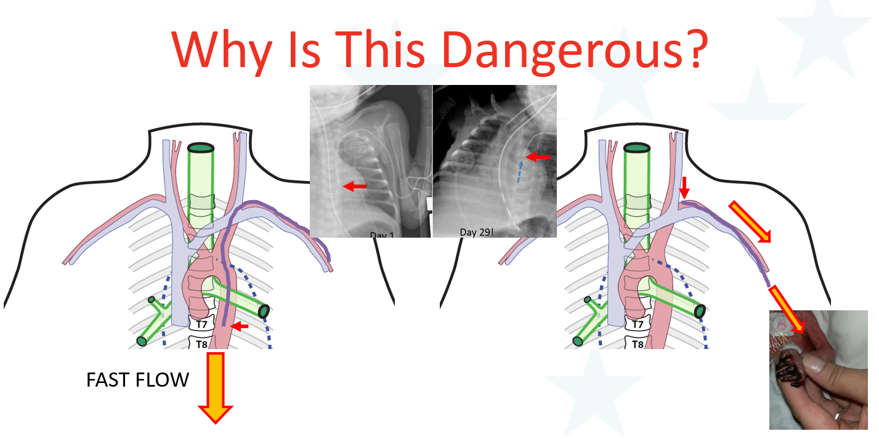
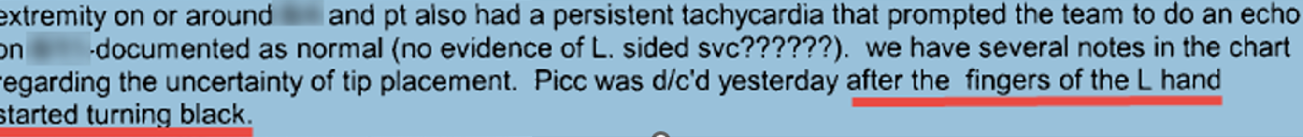

Slide 30
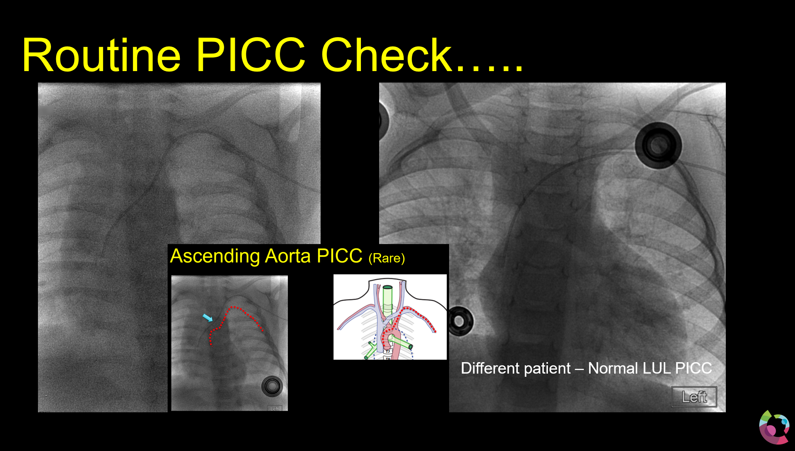
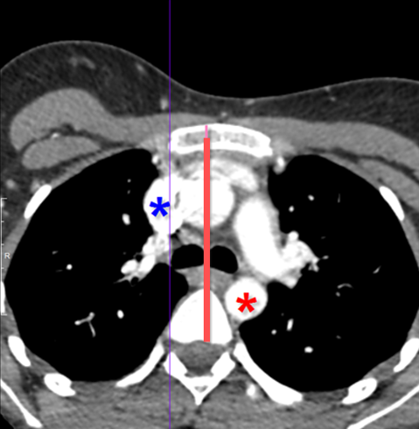
Arterial PICC → ASCENDING Aorta
Very Difficult To Diagnose on CXR
IR Tech:
PICC Nurse thinks its OK…
BUT Its Bouncing Around a Lot ..
AA

Slide 31
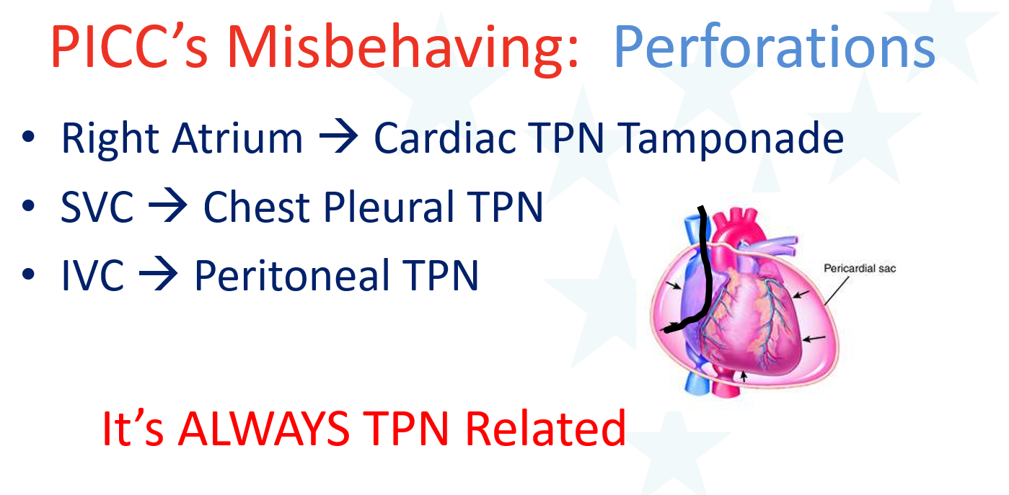

Slide 32
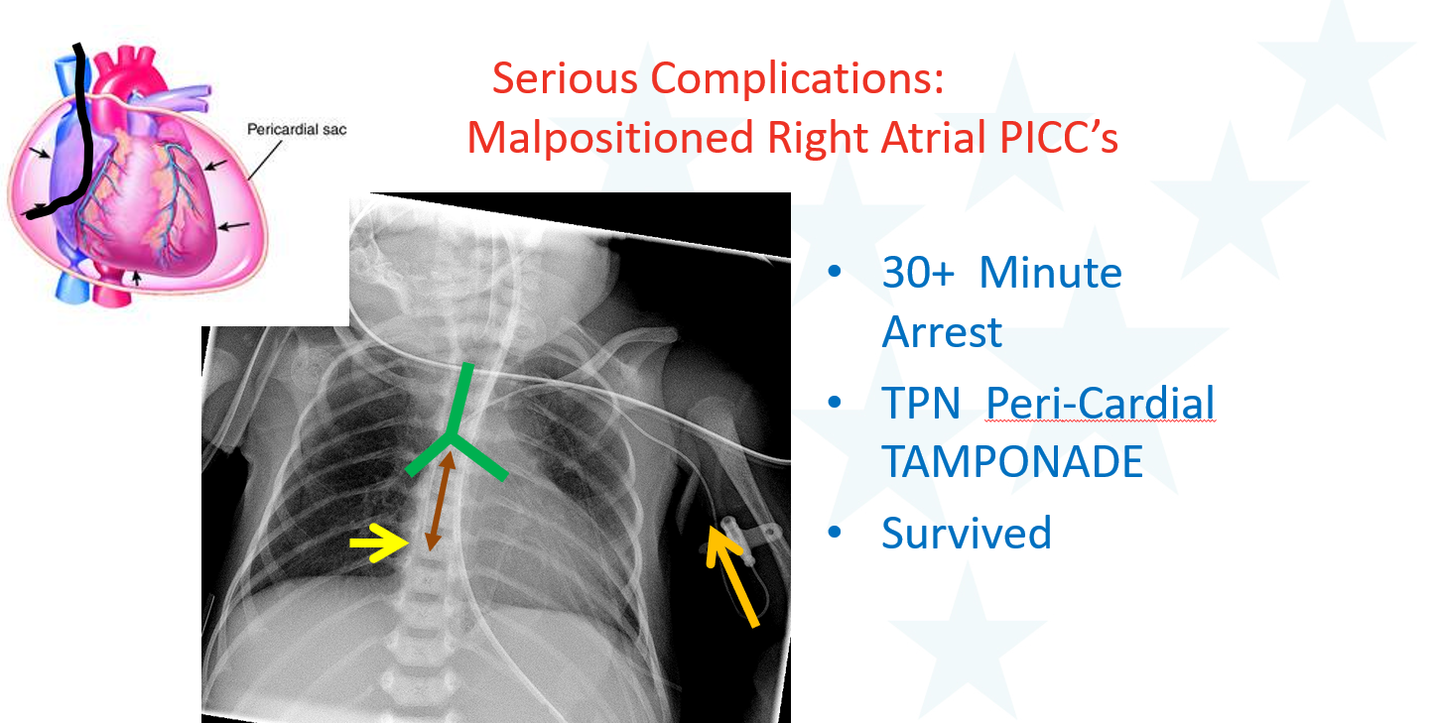

Slide 33
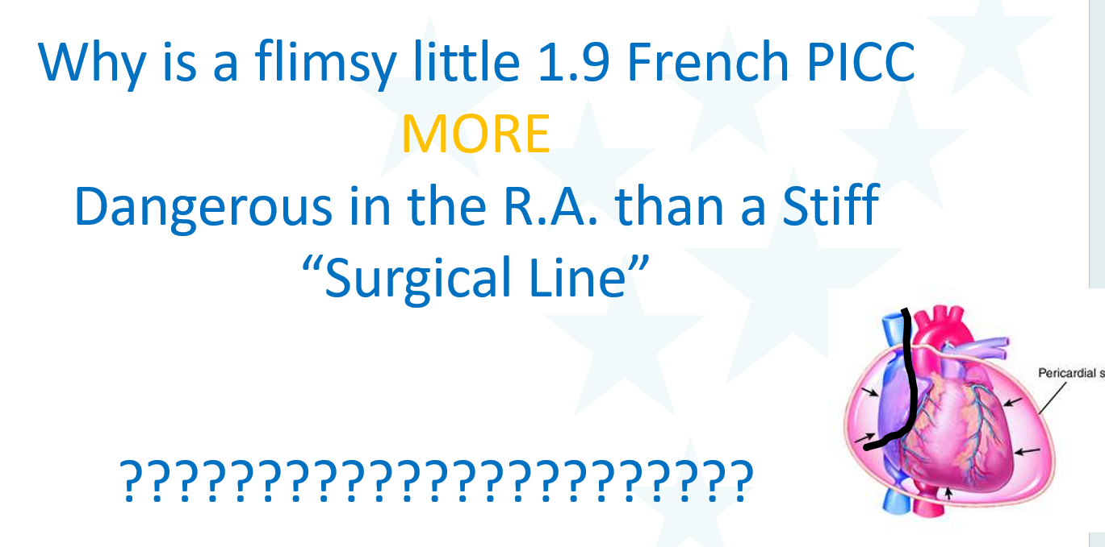

Slide 34
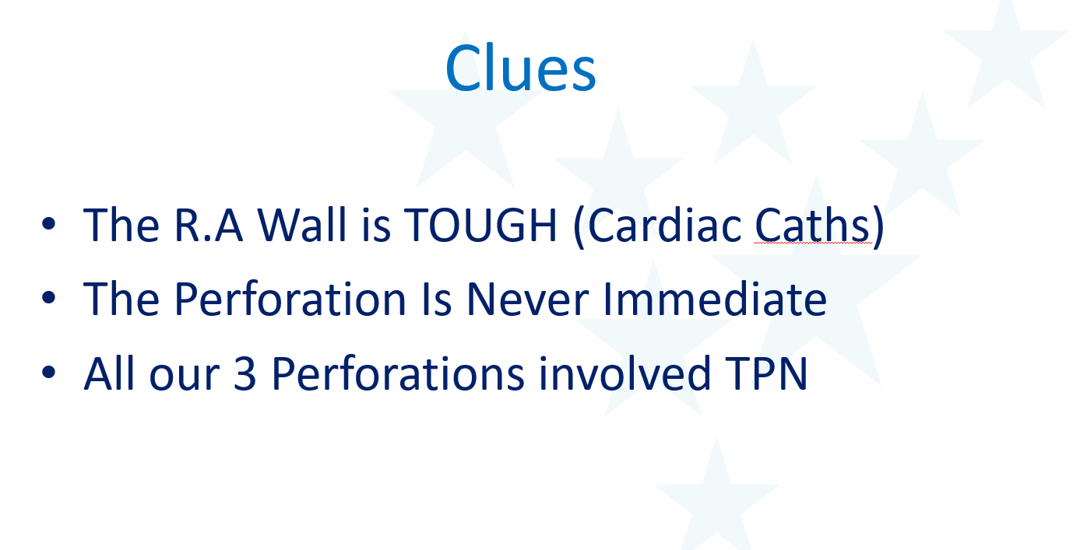
(2009)

Slide 35
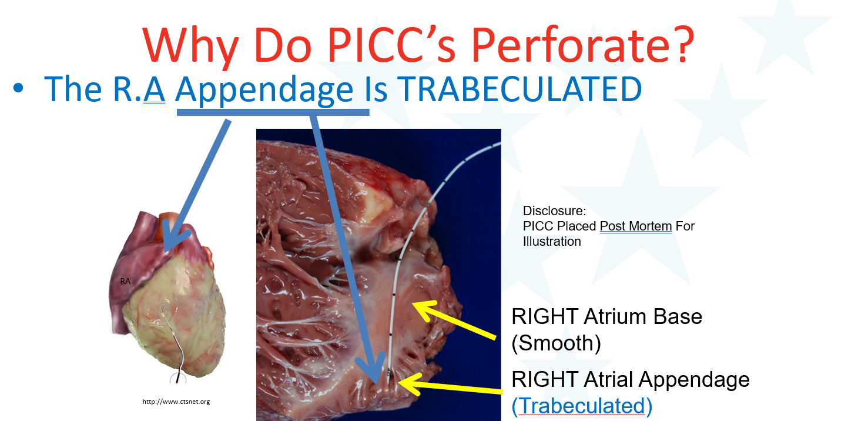

Slide 36
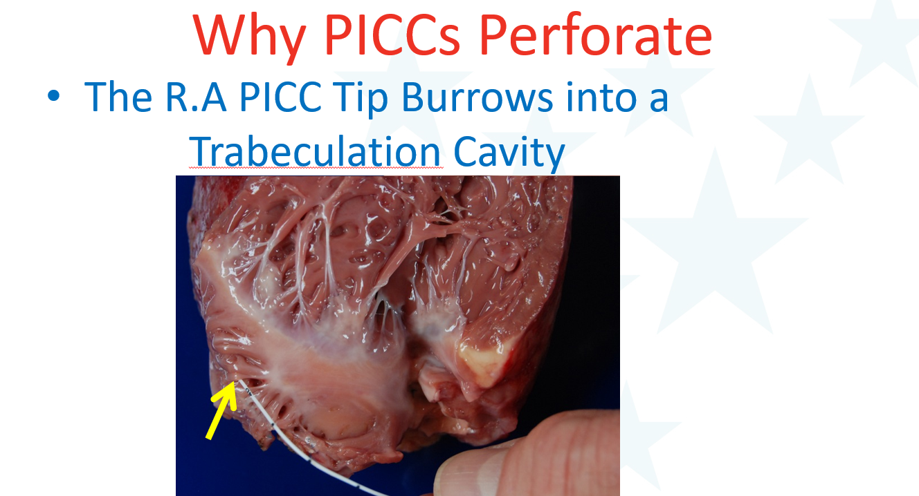
Post Mortem Simulation

Slide 37
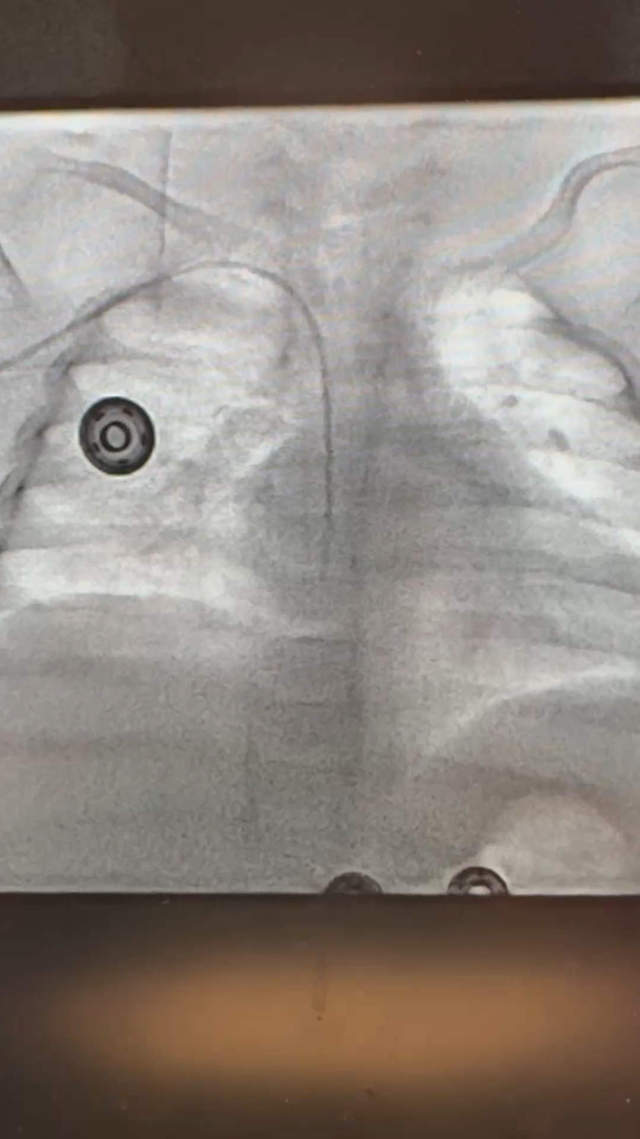
PICCs Dance Around

Slide 38
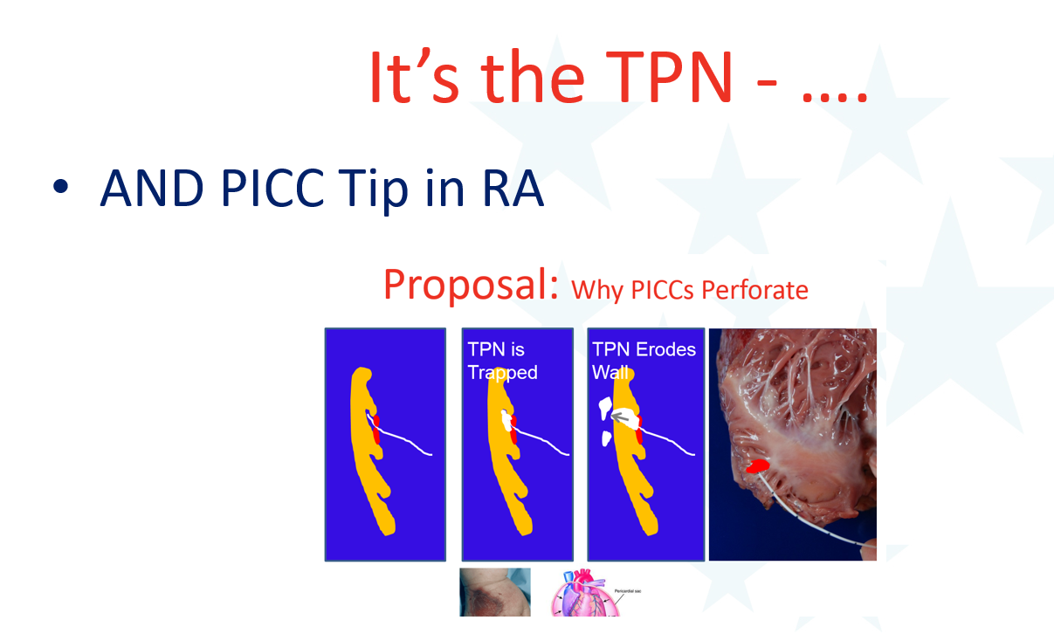

Slide 39
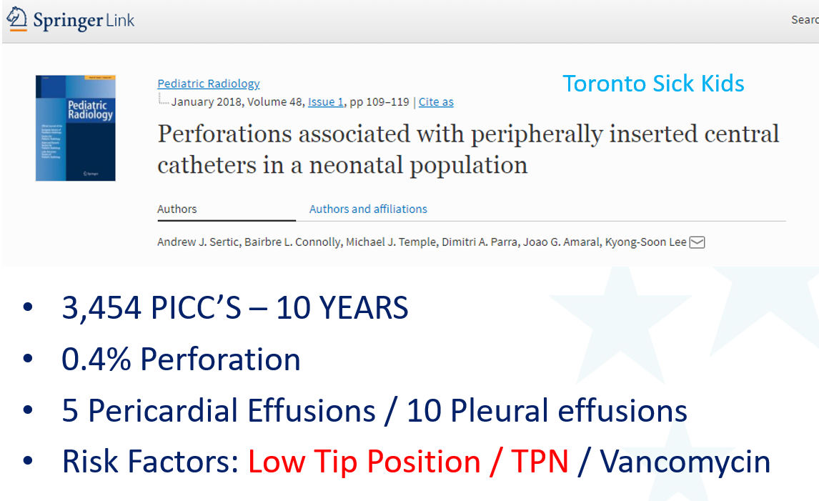

Slide 40
Since 2011 at Cincinnati
PICC Team Place 100% of NICU PICCs
PICC Tip placed by CCHMC Standards – NOT in the RA
Policy Agreed by NICU Leaders
Meticulous Monitoring of PICC Tip by PICC / Vascular Access and NICU
Result:
  Zero Pericardial Tamponade in 15 years
  Expected perforation (0.2% for 6,750 PICCs) = 13.5
  BUT – Even the airlines have occasional accidents……

Slide 41
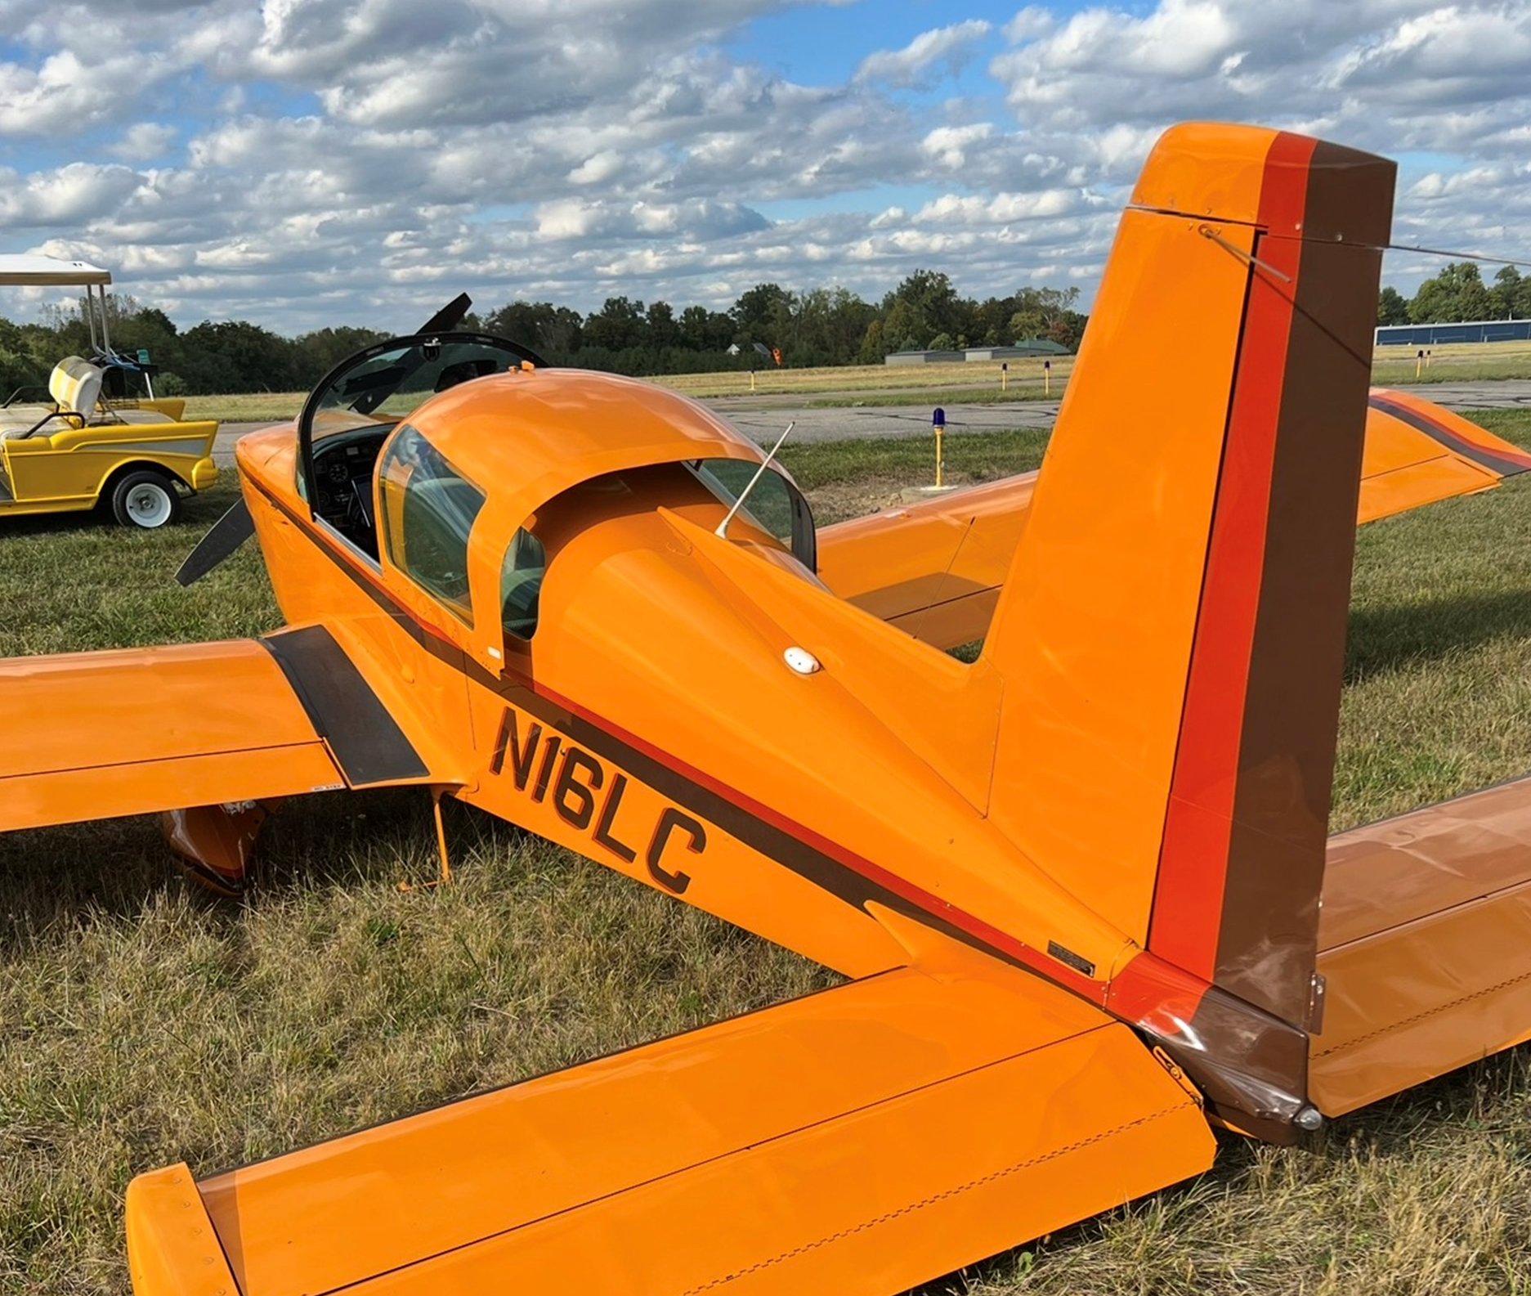
Since 2011 at Cincinnati
PICC Team Place 100% of NICU PICCs
PICC Tip placed by CCHMC Standards – NOT in the RA
Policy Agreed by NICU Leaders
Meticulous Monitoring of PICC Tip by PICC / Vascular Access and NICU
Result:
  Zero Pericardial Tamponade in 15 years
  Expected perforation (0.2% for 6,750 PICCs) = 13.5
  BUT – Even the airlines have occasional accidents……

Slide 42



PICC in Internal Mammary Vein

Slide 43

Internal Mammary Veins
Drain Anterior Chest Wall
Posterior to The Anterior Ribs
Join with Epigastric Veins from Abdomen → Femoral Veins
Can Enlarge When SVC Obstructed
Source: Chat GPT

Slide 44

PICC’s Jump Around …… Next Day
Right Jugular Vein

Slide 45


Azygos Vein Tip Malposition
Post Insertion
SVC
Azygos Vein Malposition

Slide 46



Abnormal Catheter Configuration
Left arm PICC coiled at placement, and left in place to use
Left arm PICC still coiled days later, and now sluggish to flush

Slide 47


PICC “Vacuumed” into ECMO Venous Cath

Slide 48

Unusual Places

Slide 49

Unusual Veins:
Retro-Aortic Aberrant Left Brachiocephalic Vein

Slide 50

Unusual Veins:
Retro-Aortic Aberrant Left Brachiocephalic Vein
TPN Perforation !

Slide 51

Non-Radiology PICC Tip Monitoring
Bigger Pediatric Institutions in USA Now Have 24/7 Radiography
Also Have 24/7 Faculty Radiologists
Radiation for Neonatal Chest Radiograph is Minimal
Many NICU’s and Smaller Hospitals Do Not Have These Advantages
Recent Developments In Non-Radiology PICC Tip Monitoring are Now FDA Approved

Slide 52
ECG Tip Navigation for PICC Placement
Electrocardiographic (ECG) tip confirmation – used during a PICC procedure to guide the catheter tip to the lower superior vena cava or Cavo-atrial junction by monitoring changes in the patient's P-wave
How it works:
  PICC catheter or guidewire becomes an intracardiac electrode
  The ECG monitor displays the patient's P-wave as the catheter advances
  As the tip approaches the Cavo-atrial junction, the P-wave gradually increases in amplitude, maximum upright P-wave = Cavo-atrial junction
  If the catheter is advanced into the right atrium, the P-wave may become biphasic or inverted, indicating the need to pull the PICC back
  The catheter is pulled back until the larges upright P-wave is visualized, and secured in place

Slide 53
ECG Assisted Insertion
Catheter Position | ECG Finding
Upper SVC | Small P-wave
Mid SVC | Increasing P-wave amplitude
Cavo-atrial Junction | Tallest upright P-wave (optimal)
Right Atrium | Biphasic or inverted P-wave

Slide 54
ECG Tip Navigation for PICC Placement
Benefits
  Eliminates routine post-procedure chest x-rays in appropriate patients
  Immediate tip confirmation
  Faster catheter use
  Reduces radiation exposure for patients, as well as overall cost
  Decreases line placement delays
  Highly accurate
  Best Practice
  Combine ECG navigation with ultrasound-guided venous access
  Use sterile technique throughout insertion
  Confirm the patient is in sinus rhythm before relying on ECG guidance
  Follow institutional policy regarding confirmatory imaging

Slide 55
ECG Tip Navigation for PICC Placement
Evidence Based
INS standards support intracavitary ECG as preferred method for bedside PICC tip confirmation in appropriate patients
AVA supports the use of ECG tip navigation whenever available during PICC insertion
Studies have shown sensitivity and specificity commonly exceed 95%
Tip malposition rates are decreased compared with blind insertion
Limitations for use
Not appropriate for patients with :
Atrial fibrillation/flutter, Absent or poorly defined P-waves, some paced rhythms or significant congenital or altered central venous anatomy

Slide 56


Cincinnati Children’s Hospital and Medical Center
Vascular Access Team
VAT Total FTE: 47
RN FTE: 38 or 52 RNs
PICC RN FTE: 9 or 12 RNs
VAT Members: Director, Manager, Educator, RNs, PCAs and Child-Life Specialist
Under Peri-Operative Services
Medical Director, IR Attending

Slide 57


What we do
PIV placements per year = 25,000
PICC placements per year = 1,400
Lab draws = 6,500 (despite in house phlebotomy team)
Central line experts
Central Line Education
CVC Line Repair
Central Line Occlusion Management and Troubleshooting
Difficult Port Access
CVC Dressing Management
Collaboration with Bedside Teams and Providers

Slide 58
Central Line Monitoring
Daily report sheet printed of all inpatients with a central line
Base and satellite locations
Team monitors approximately 250-300 lines daily
Annual staff competencies for monitoring of central Lines
EPIC chart reviews
Review of imaging for line tip placement and positioning
Address line tip concerns with patient’s provider in real-time, phone or bedside
Discuss with IR Attending if necessary, and have an “attending to attending” conversation if the line tip is in an unsafe location and concerns are not addressed
Dressing Complications and Concerns
Temperature/Blood Culture
Assessing Patient in-person
Lead and Support PIVIE HAC, CLABSI HAC and Shared Governance

Slide 59

Cincinnati Children’s Hospital and Medical Center
Vascular Access Team
PICC Team
Nurse-led team, IR backup and line exchanges
PICC insertions in IR, OR, Bedside (ICUs)
Coverage in house 0700-1900/7 days, on-call overnight for “urgent” PICC insertions in the ICUs only
Cover main hospital and one satellite
12 RNs with a total of 225 years nursing experience
PICC Procedures
Consult System
2 RNs/1 PCA/Child-life
30% in OR – increasing number, combo with OR cases – best option for pediatric patients
20% in IR – new insertions, line exchanges with IR MDs
50% ICU Bedsides – unstable patients, too ill to travel to IR suite
All ultrasound guided insertions

Slide 60

Thank You…Questions?

Slide 61

**IMPORTANT**
**IMPORTANT**
Record the Session ID and CE Code below to earn continuing education credit for this session
Record the Session ID and CE Code below to earn Continuing Education Credit
Session ID
CE Code

