Slide 2
PICC Tip Location:
The Why Behind The Where
Systems Thinking: Minimizing PIV and CVC Injuries
Standardization With Respect for Complexity
Continual Iterative Monitoring and Training

Slide 3



Neil Johnson MB.BS. M. Med. FRANZCR
Jamie Webb MSN, RNIV, Va-Bc
Disclosure of Relevant Financial Relationships​
We have no financial relationships to disclose.​
​
Disclosure of Off-Label and/or investigative Uses​
​
We will not discuss off label use and/or investigational use in our presentation.​

Slide 4
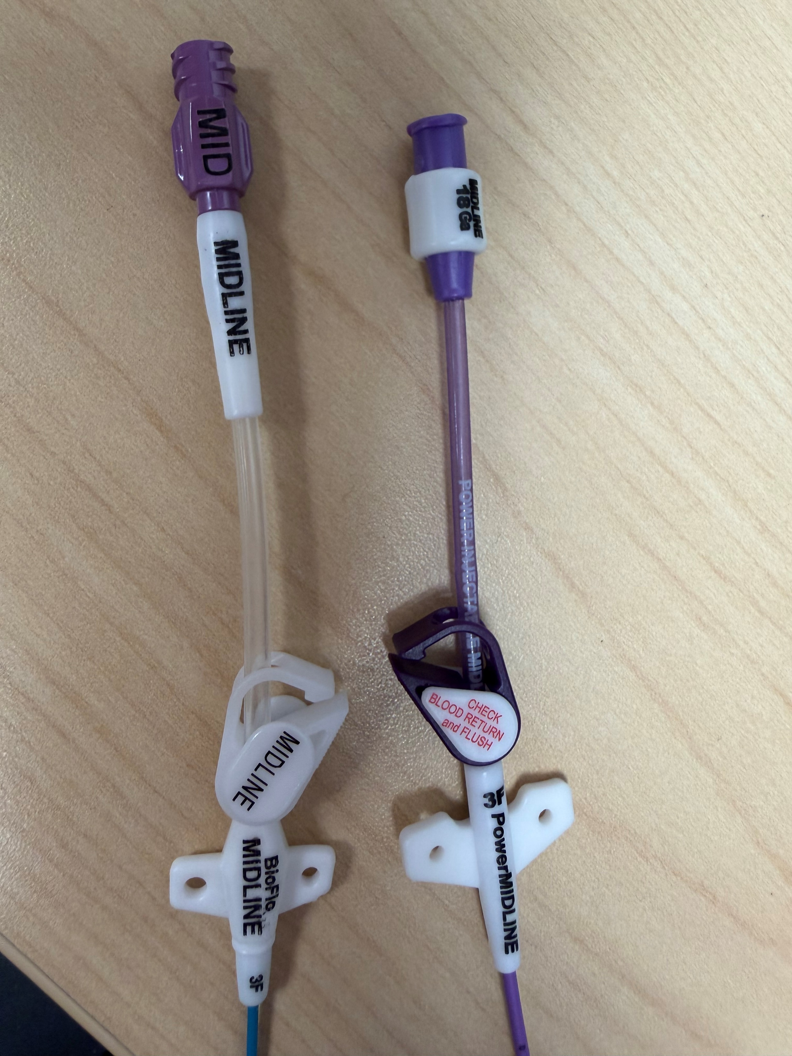
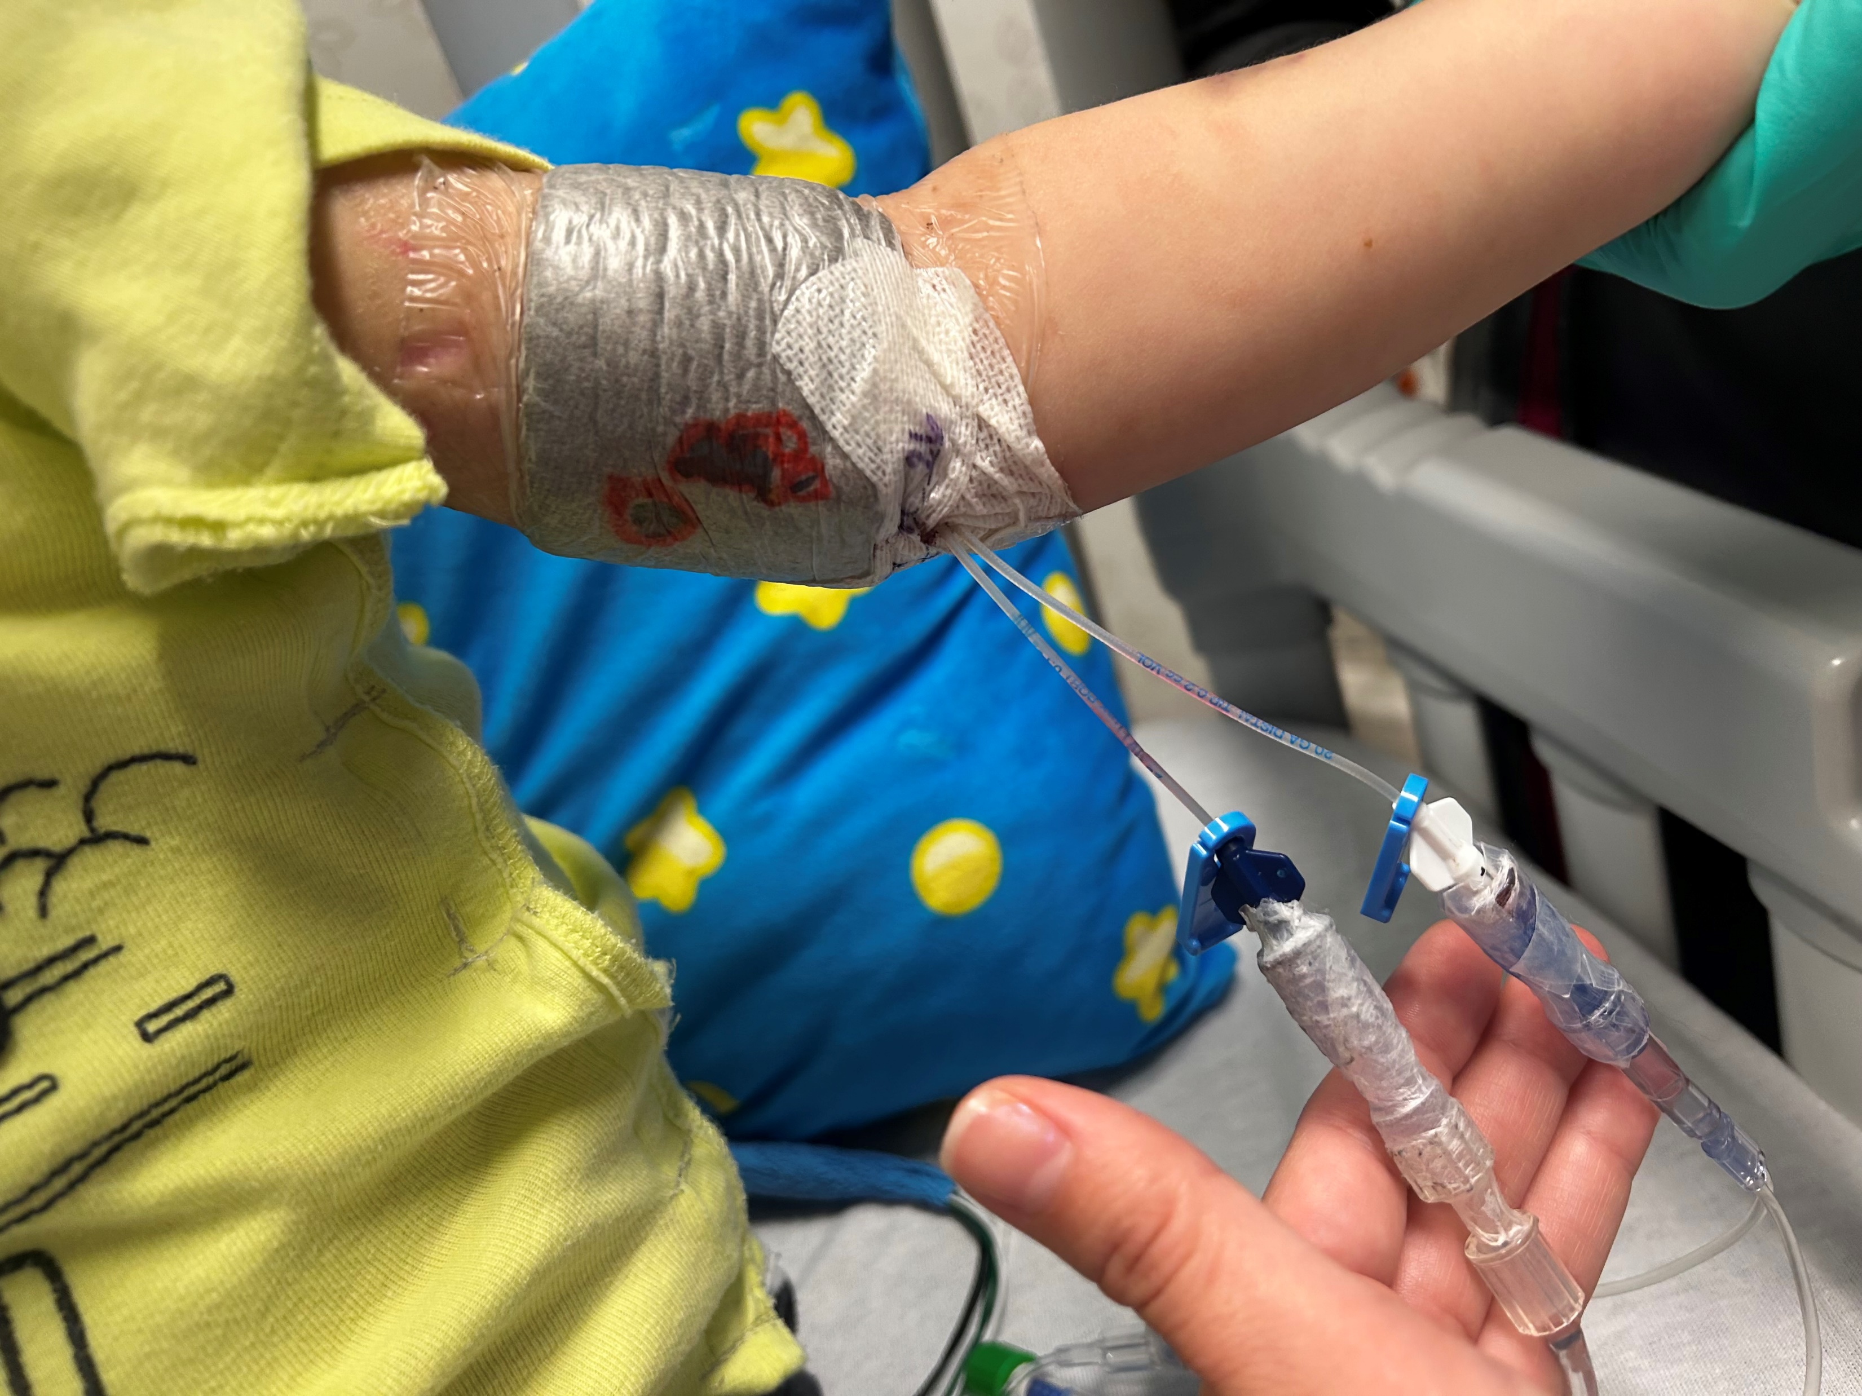
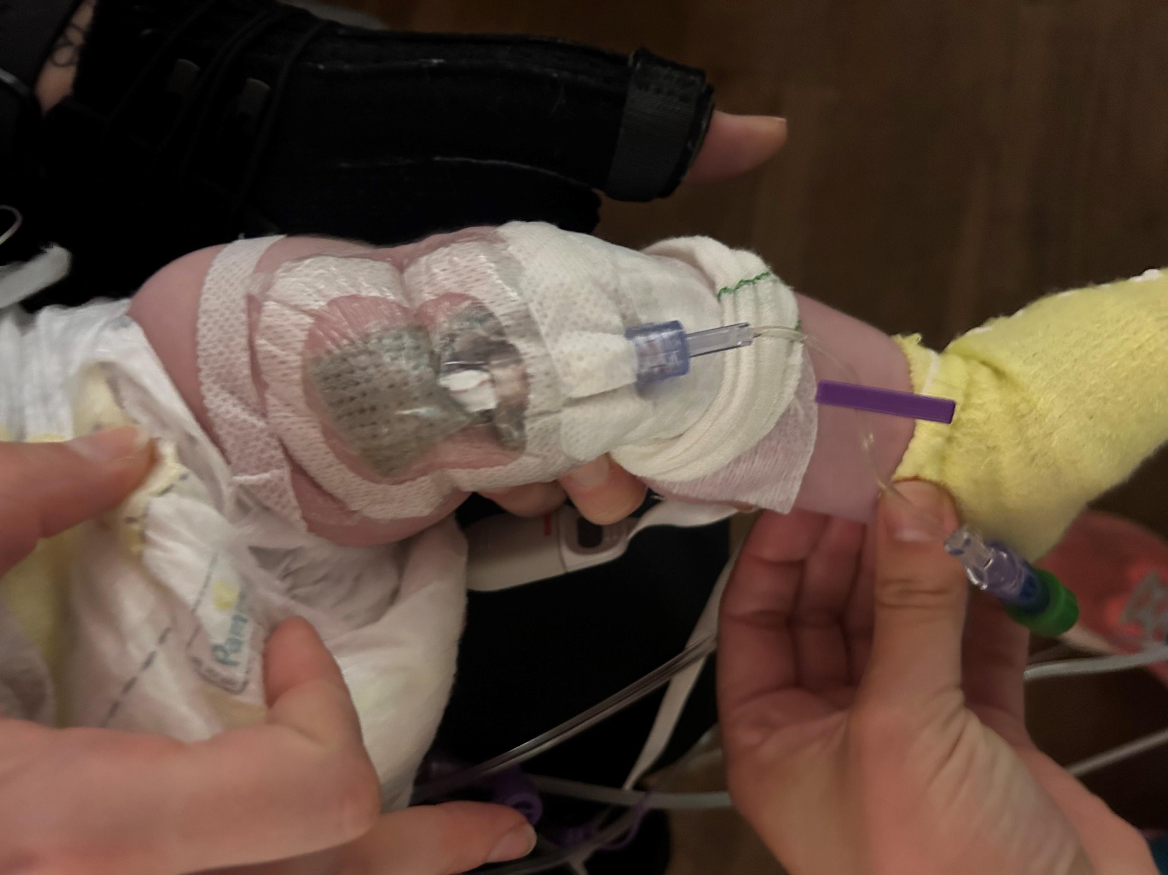
CCHMC:
We Need to Label Vascular Device Hubs…
Device TIP POSITION is What Matters
Where is the TIP?

Slide 5
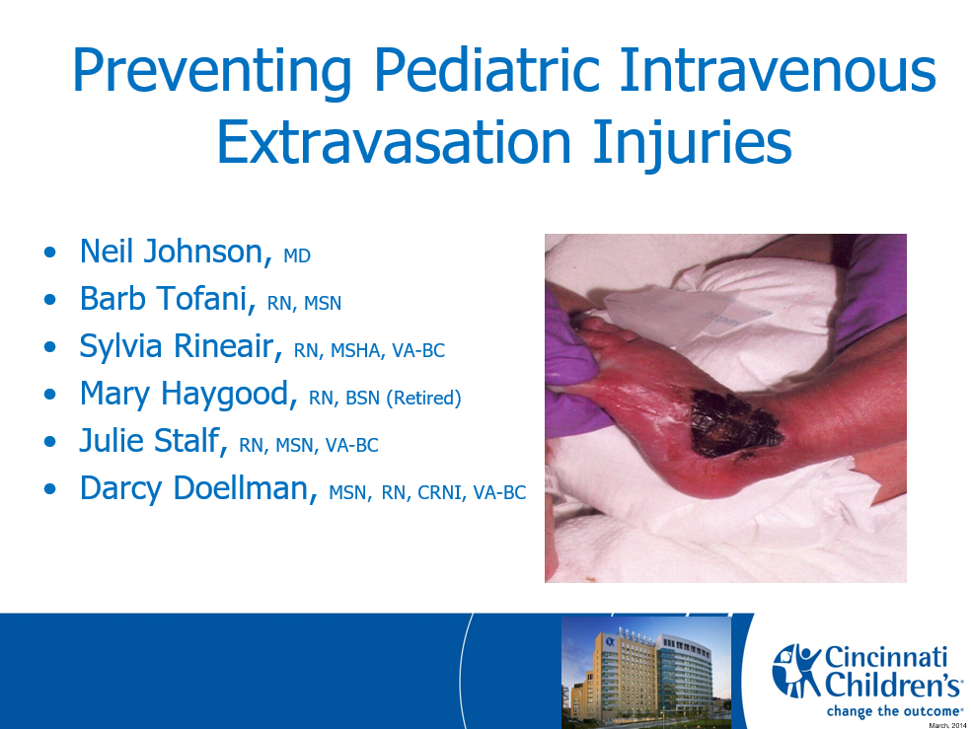
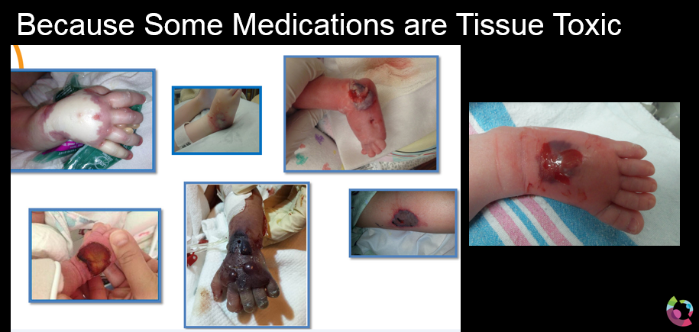
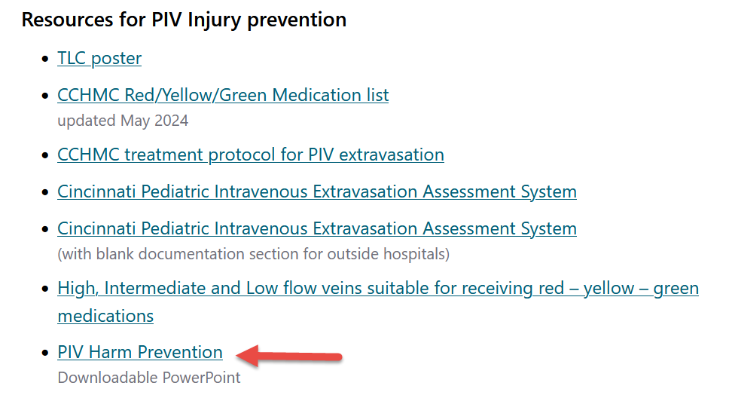
2009 …Unacceptable Injuries
This Started our Vascular Safety Journey
  Multiple serious PIV Injuries
Stopivharm.org
2010
Nationally Ranked Pediatric Hospital (Not CCHMC)
CCHMC

Slide 6
2009 …Unacceptable Injuries
This Started our Vascular Safety Journey
  Multiple serious PIV Injuries
Stopivharm.org
2010
Nationally Ranked Pediatric Hospital (Not CCHMC)
CCHMC
2026 – CCHMC
Zero Skin Loss PIV Injuries – 5 years

Slide 7
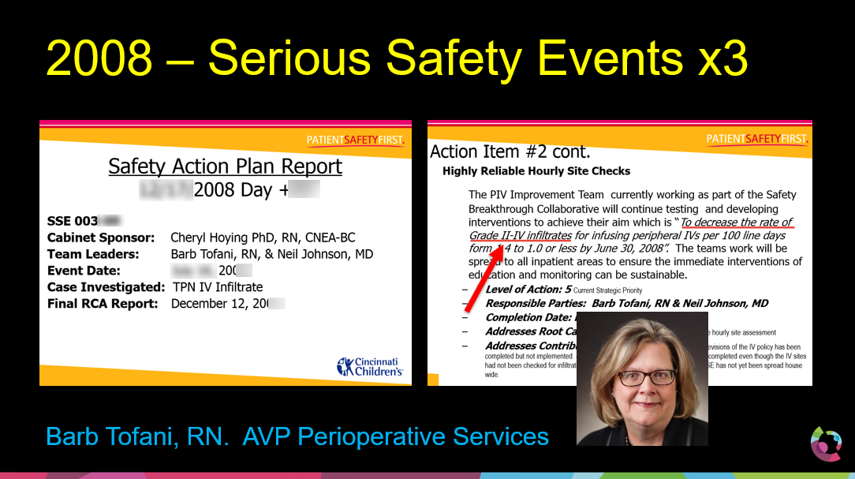
2009 … In the Beginning…….
CCHMC: PIV / PICC Safety / Improvement Work

Slide 8
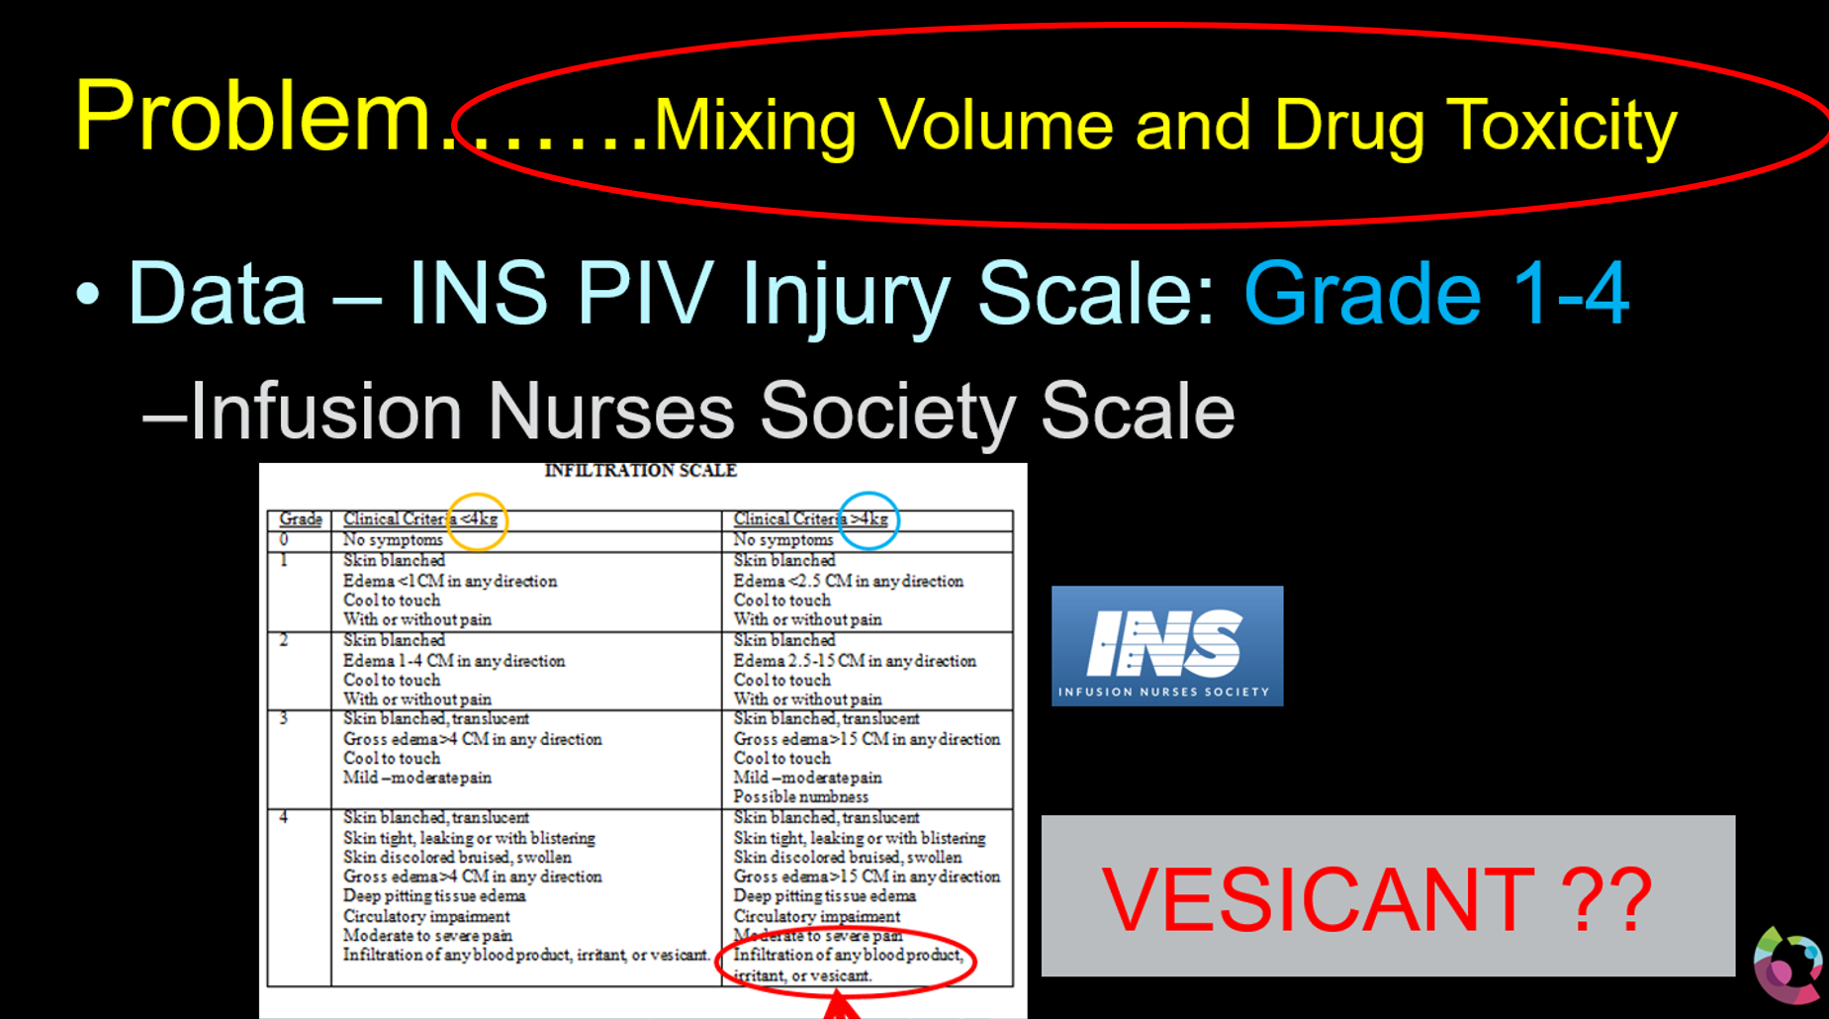
The INS PIV Grading Scale: CCHMC 2010

Slide 9
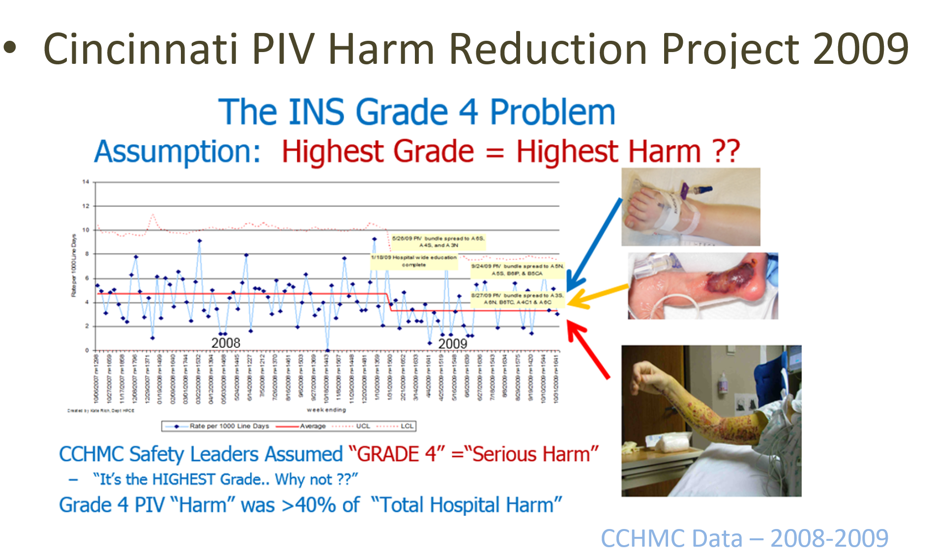
The Safety Improvement “Problem”

Slide 10
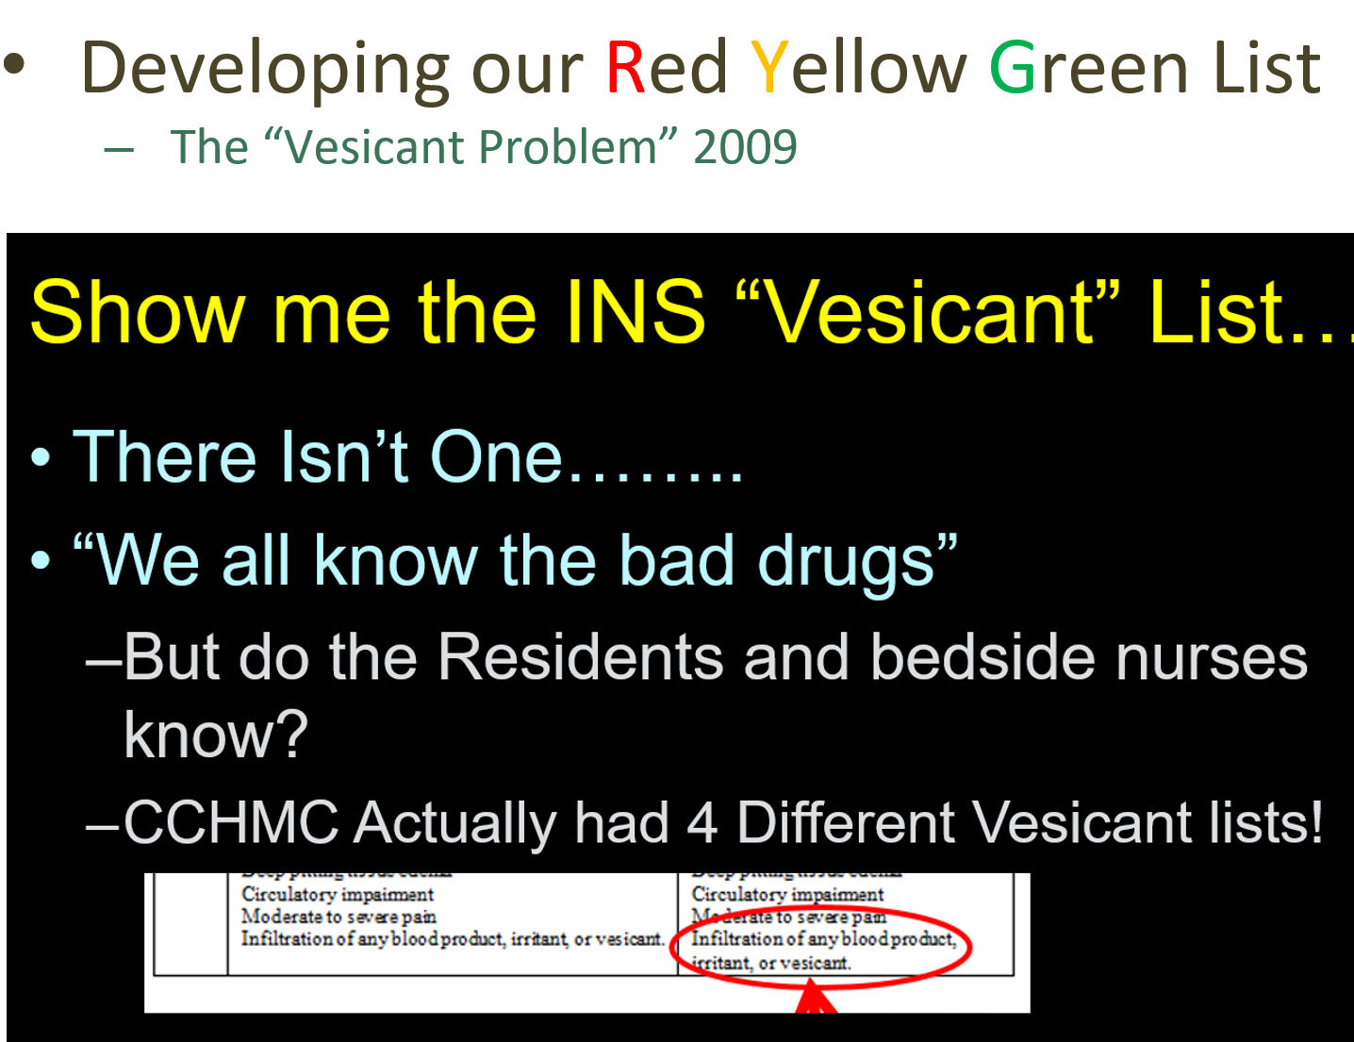

Slide 11
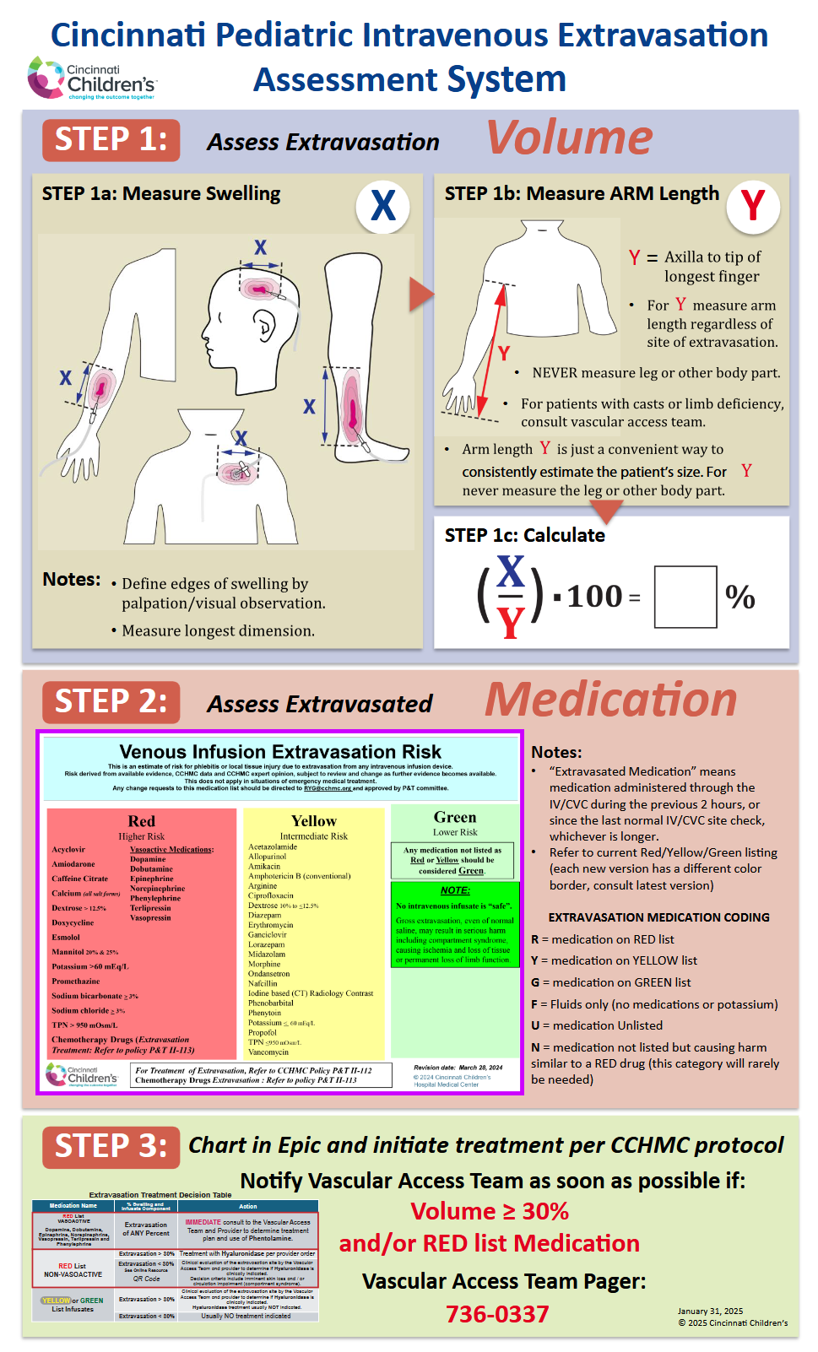
So……We….
Abandoned the INS “Grading System”
Started with Blank Sheet Redesign
Separated the Two Major PIV Injury Components
  VOLUME
  “BAD” Drugs and Infusates
Developed an Evidence Based “Bad Drug” List (RYG)
Removed Descriptive Terms
Created a NUMERIC Assessment of Extravasation Volume (%)
SIMPLIFIED the TERMINOLOGY
  “Vesicant” Replaced with (RYG)Terminology
  Abandoned “Infiltrate” Vs “Extravasation” Replaced with ONLY “Extravasation”
Educated and Spread Institution-Wide
EXTRA = “Out Of” VASA = “Vessel” …… ExtraVasation = Stuff Outside the Vessel

Slide 12
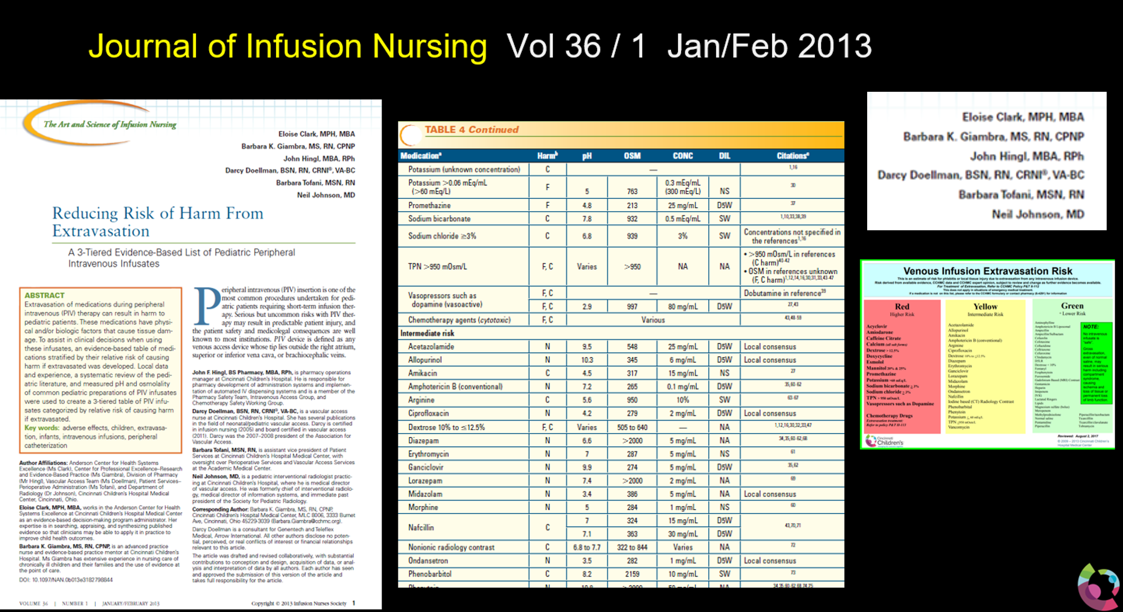
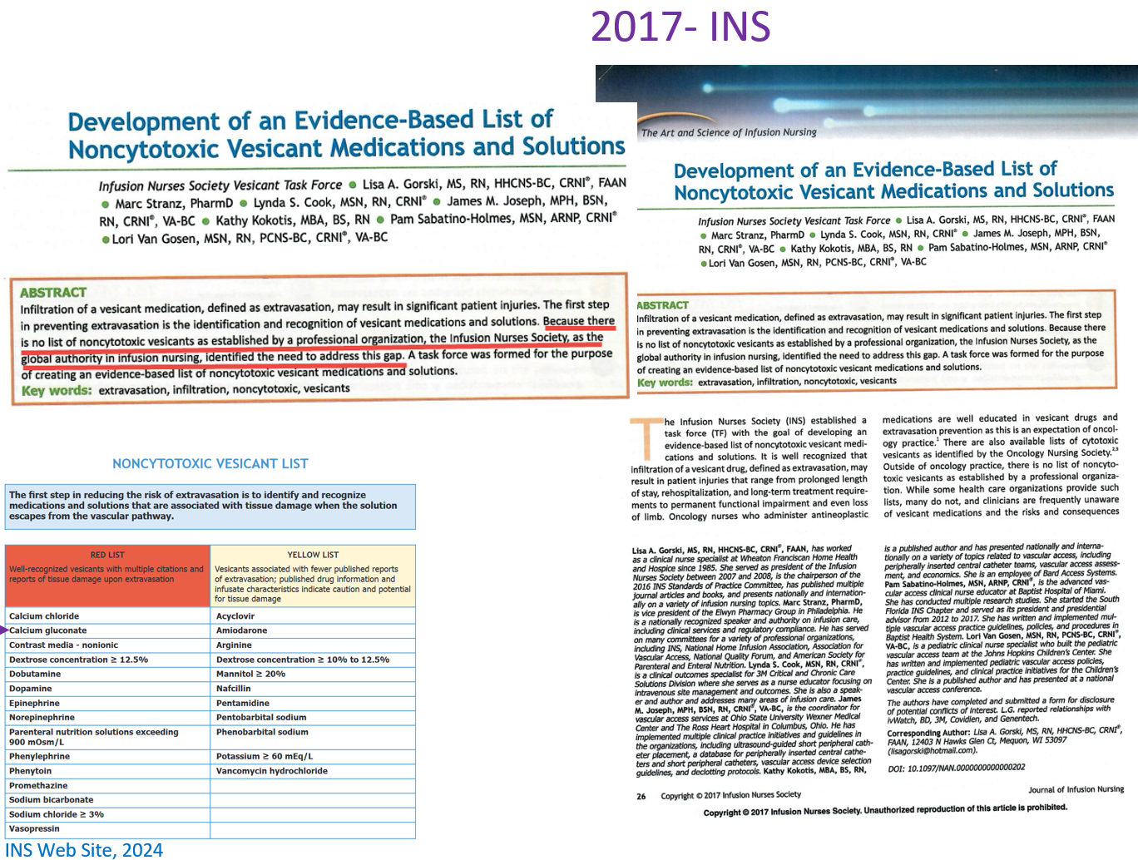
The Cincinnati “Bad Drug” List The INS List
Measured pH and Osmolarity of COMMON DILUTIONS
Published 2013
Published 2017
RED Drugs:
- pH >9 or <5 (In Common Dilutions)
- Vasoactive Drugs
- Osmolarity > 950 mOsm
- Strong Literature Evidence

Slide 13
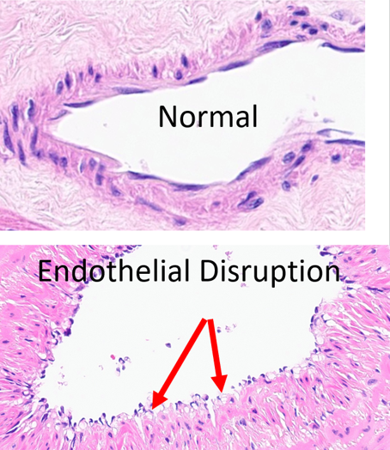
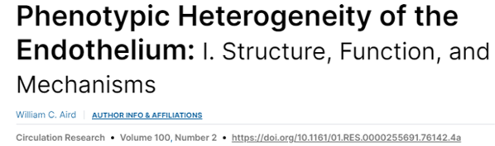
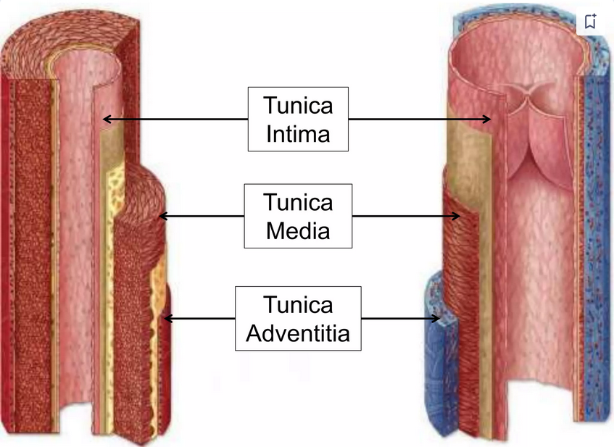
Why are Bad Drugs “Bad”? …It’s the Endothelium
Venous Anatomy
“Endothelium”
This is what RED Drugs Do
To Endothelium
https://www.slideshare.net/slideshow/histology-of-blood-vessels/187047892
Courtesy Dr Sara Szabo, Cincinnati Children's Hospital 7/2024

Slide 14
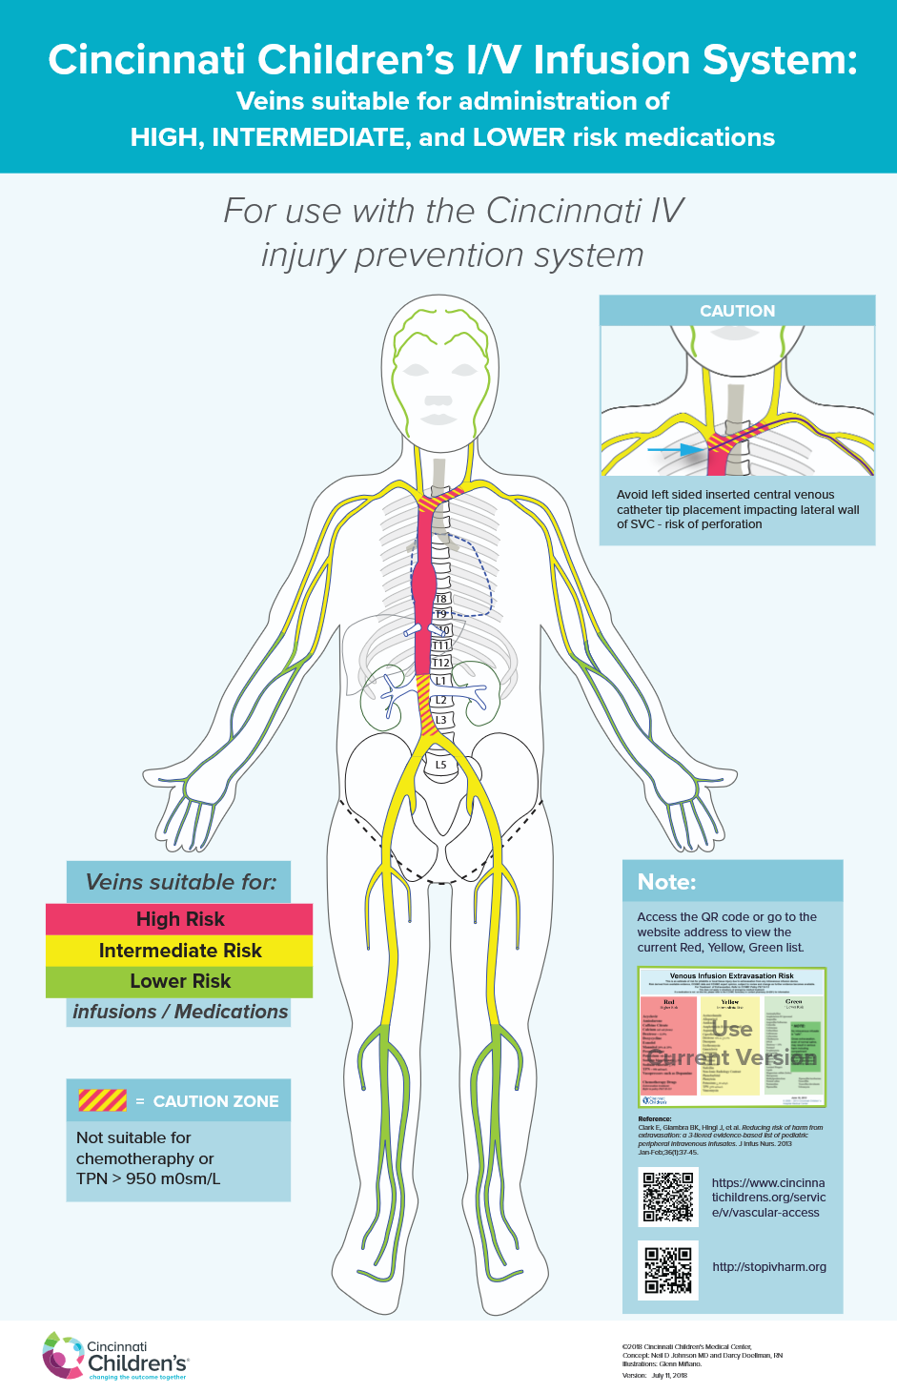
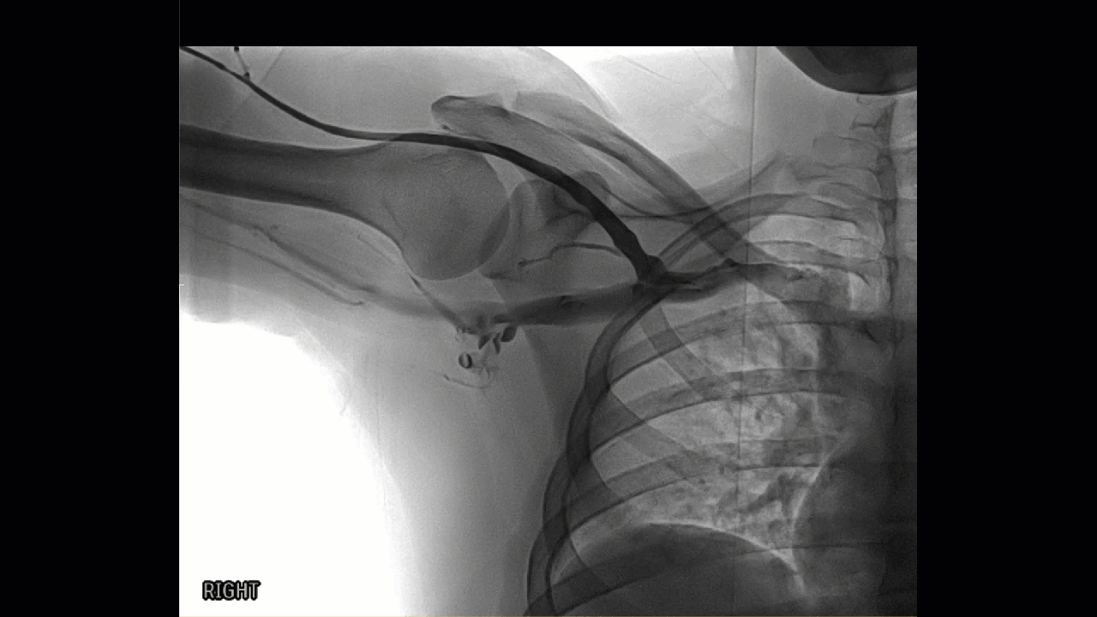
Fast Flow:
Dilutes Red Drugs and Protects Endothelium

Slide 15

So…. We Created a RYG …VEIN Diagram
Based on…. VENOUS FLOW
Because High FLOW …
  Rapidly Dilutes BAD Drugs
  Reduces Injury to the Endothelium
RED Drugs → Vascular Device Tip in RED Vein
Yellow Drugs → Vascular Device Tip in Yellow (or Red) Vein
Green Drugs → Vascular Device in Green (or Red/ Yellow) Vein
      There ARE Exceptions….

Slide 16
If You Don’t Give Red Drugs into a Green / Yellow Vein …..
You Don’t Get Skin Loss and Serious Complications!
CCHMC 2021-2026: Zero Serious Skin Injuries ….
Exception: Intra Operative Mannitol RCA Case, OSH + I/O CodeCase

Slide 17
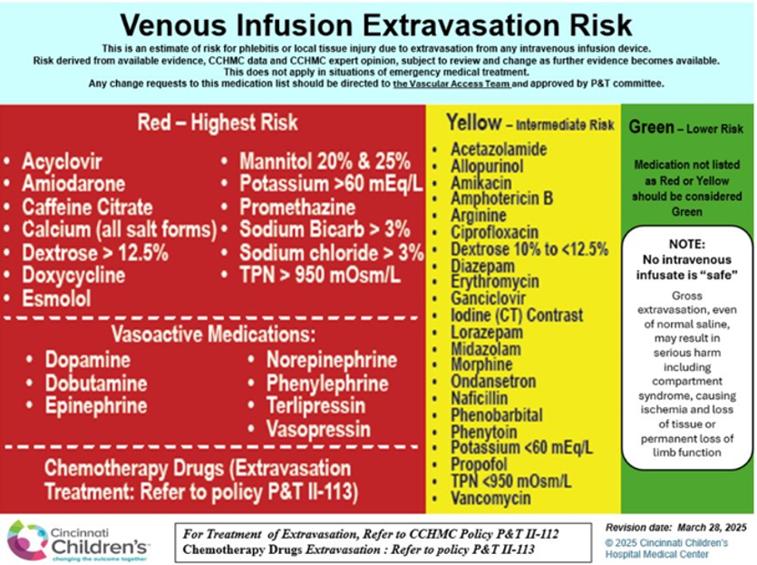
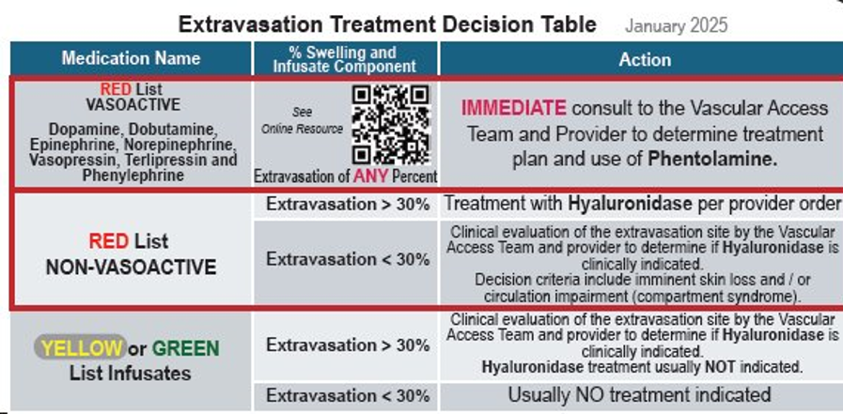
RN / MD Badge Cards

Slide 18
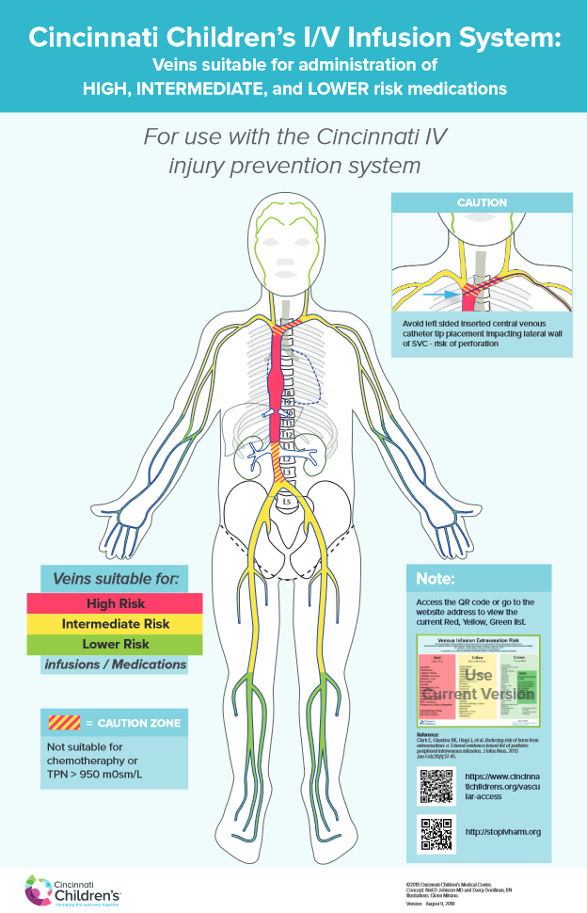
Flow Based Decision Making …
Replacing “CENTRAL” with "FLOW"
July 1 Questions to Radiologists:
  Is it CENTRAL?
  Is It SAFE to Use ?
Depends…
  Medications Intended
  Duration
  Other Issues
PICC tip in Brachiocephalic Vein
  2 Days of simple ABX and Fluids Remaining → OK
  6 Weeks of 1630 mOsm TPN → NOT OK
https://stopivharm.org

Slide 19
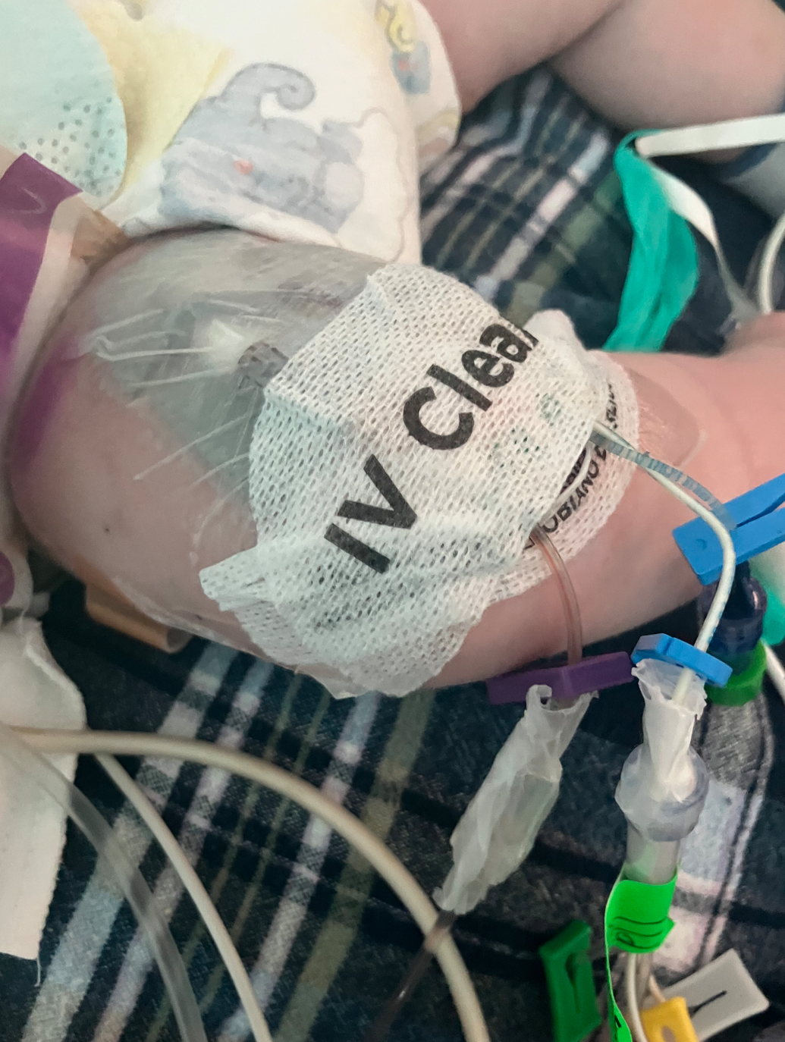
So… “Where is the Tip of the Venous Access Device
*
What’s the Issue?
“The Bedside Nurses know what line is Arterial”
….But Does the CRNA?
….Does the MRI Tech . CT Tech / Nurse?
“I know what meds I have on my IR /OR table”
  “Lets stop labelling medications in the OR”
*
*

Slide 20
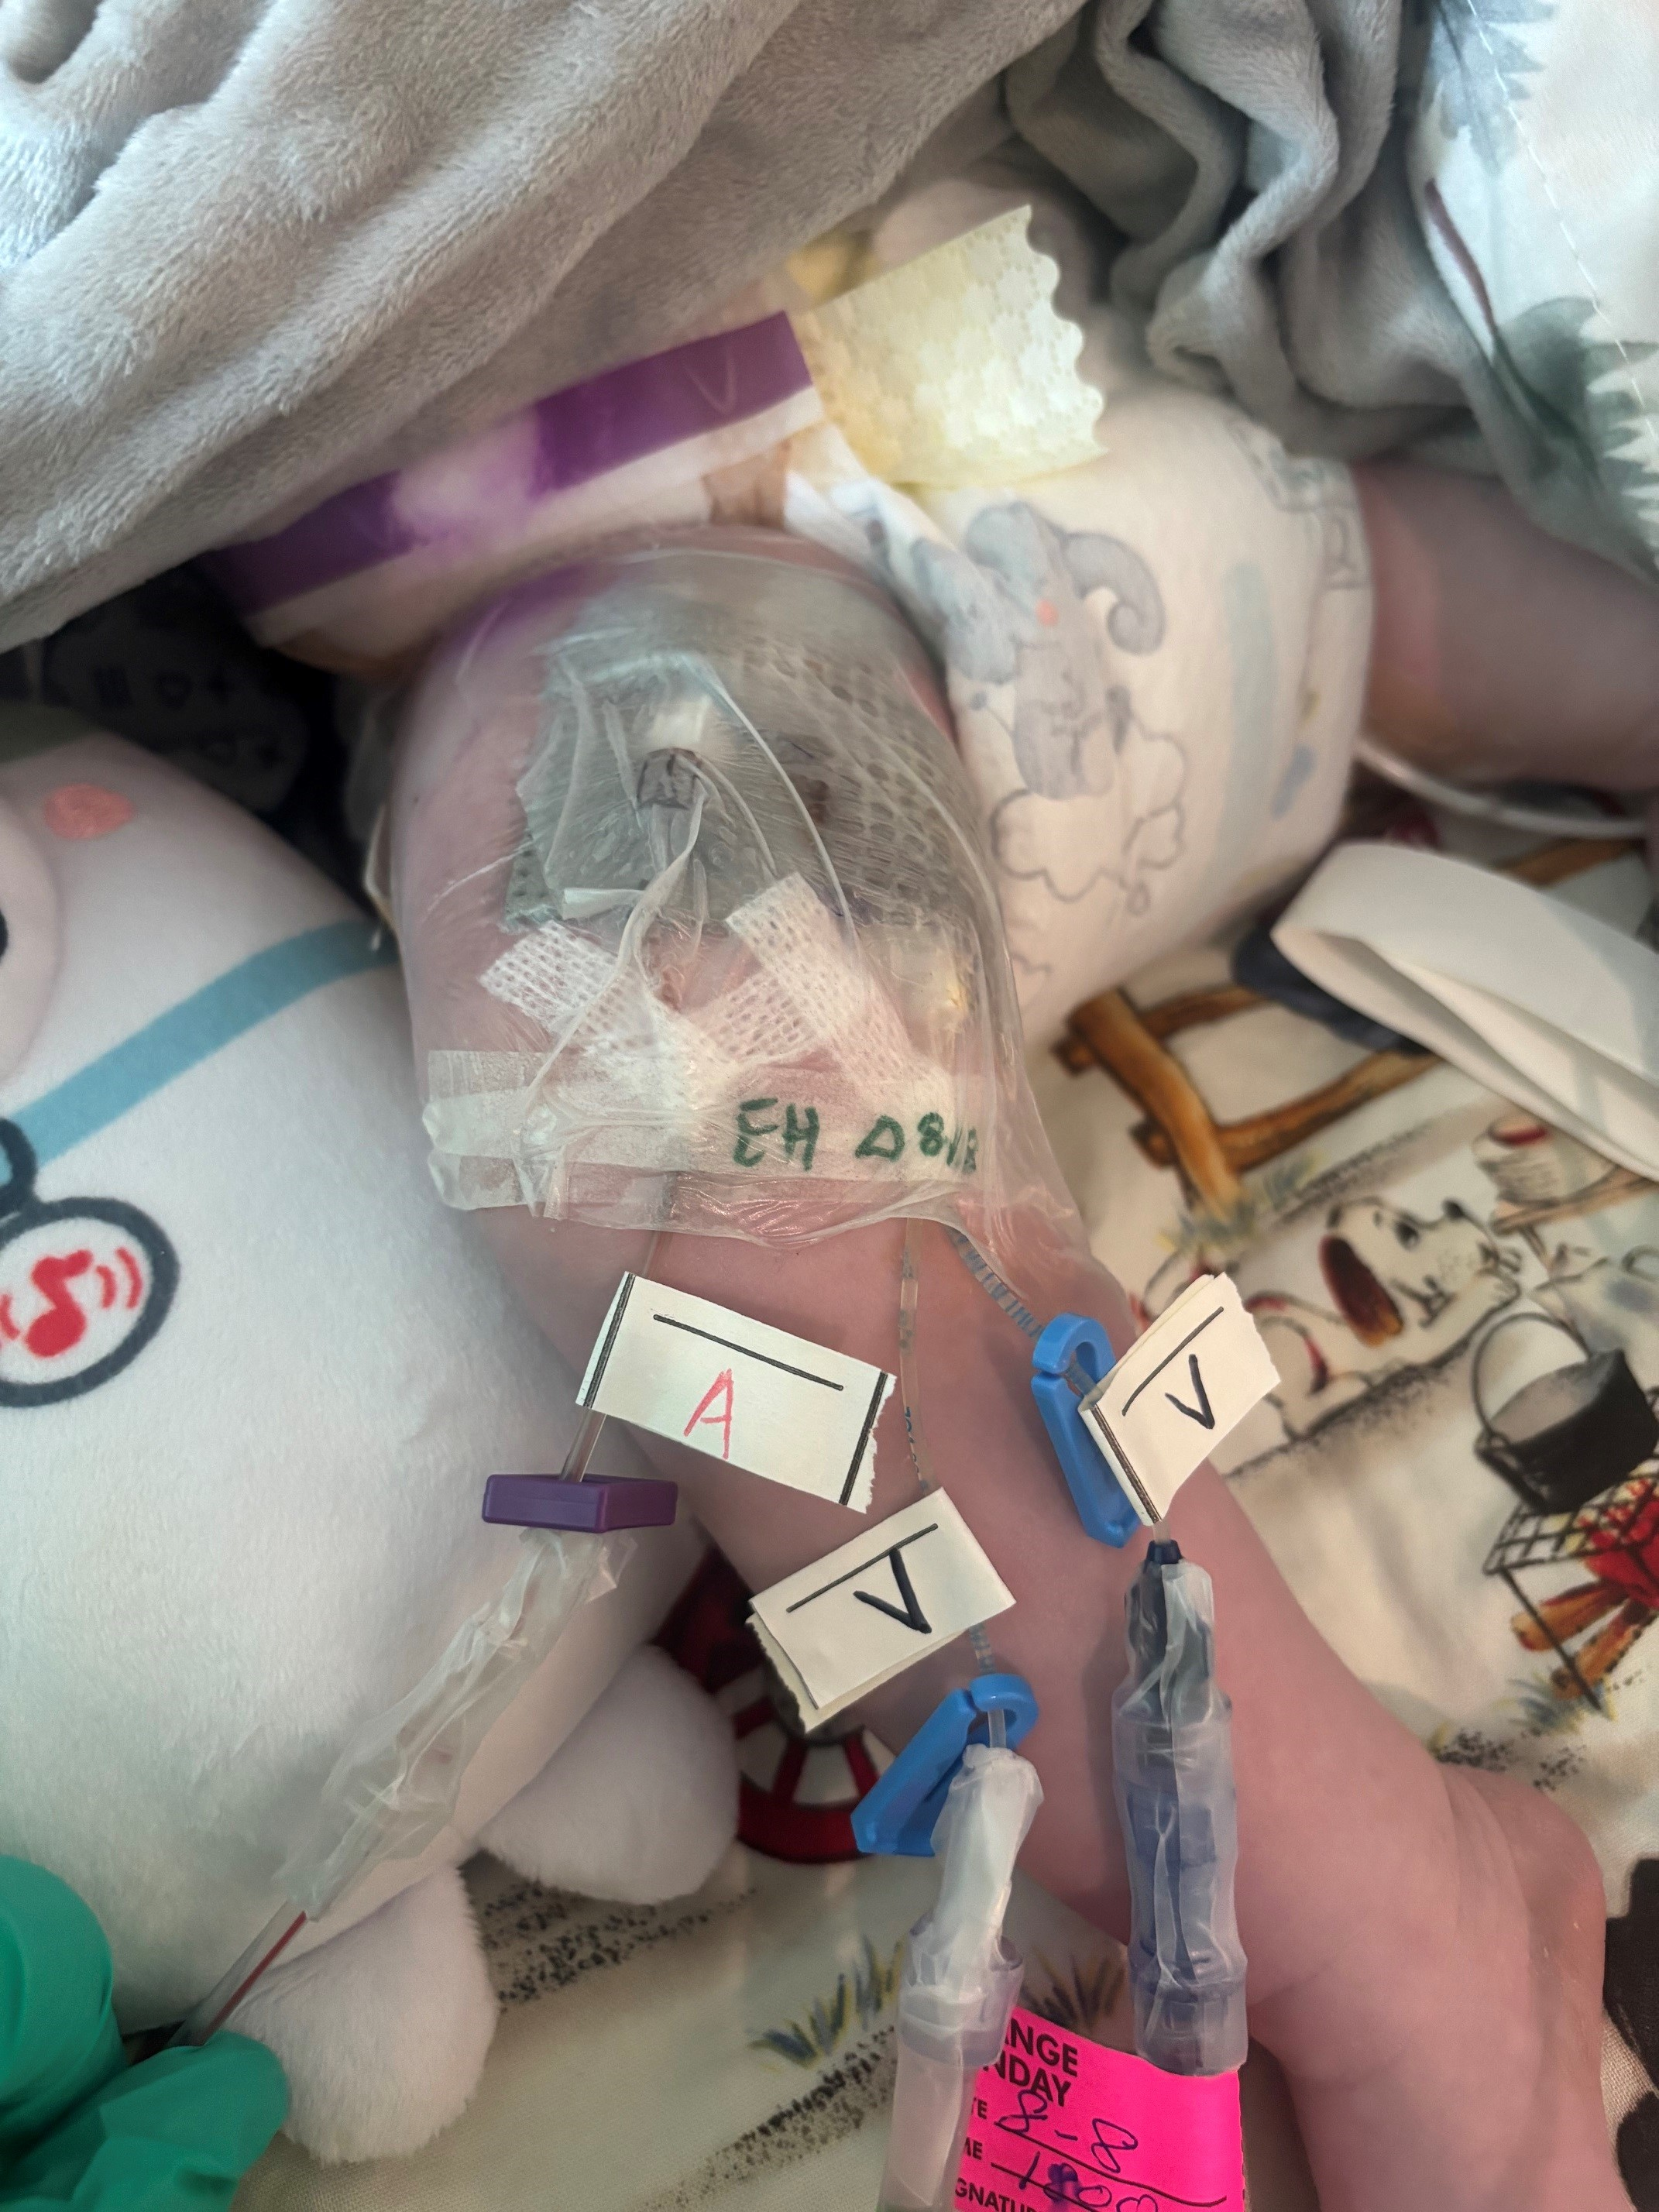
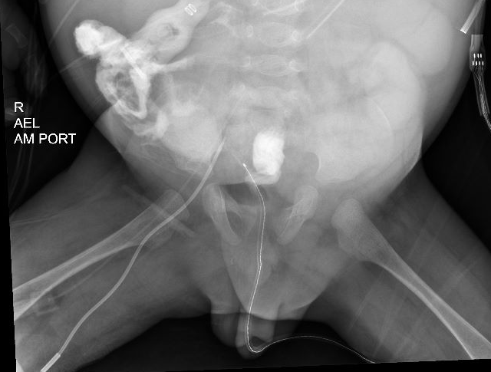
Which is Which ?

Slide 21
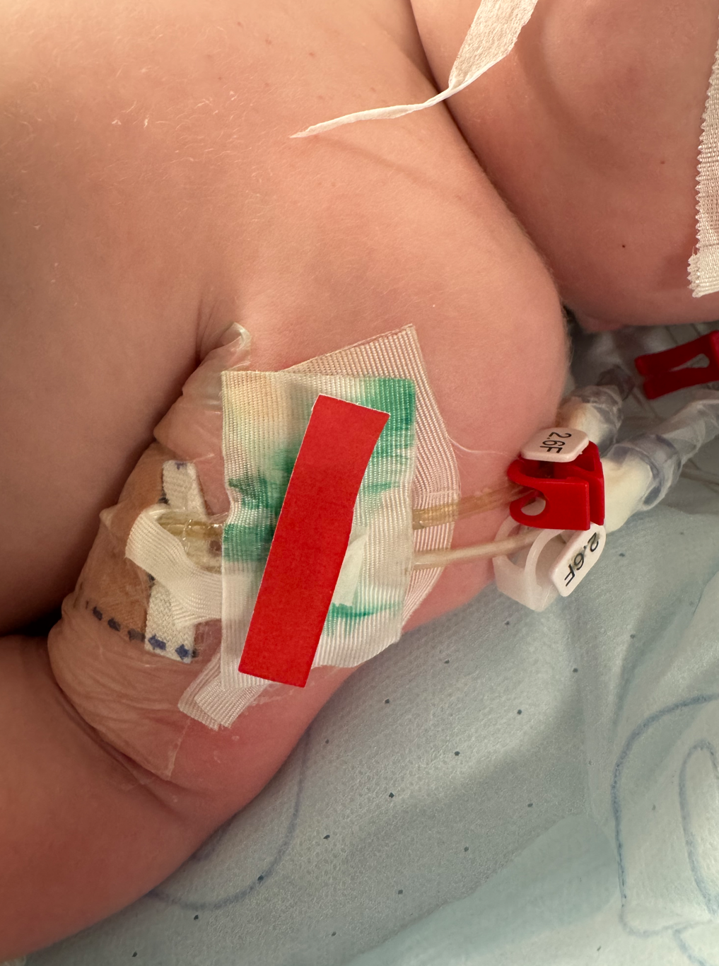
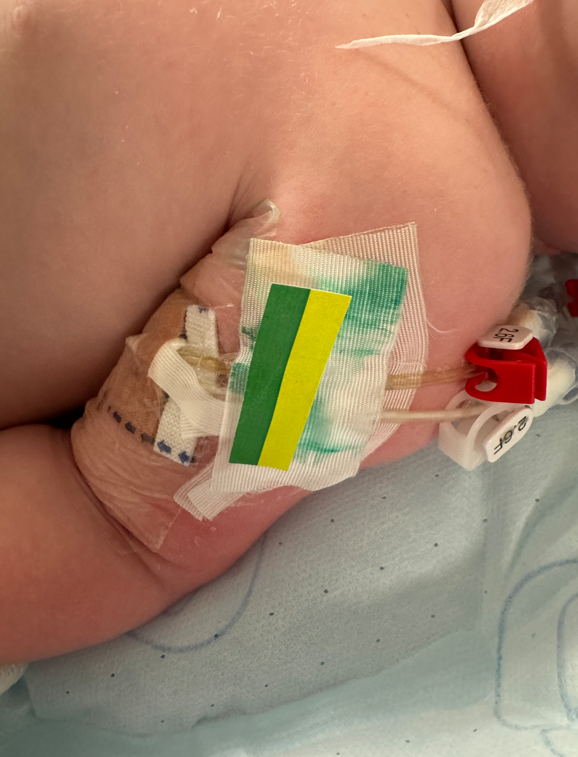
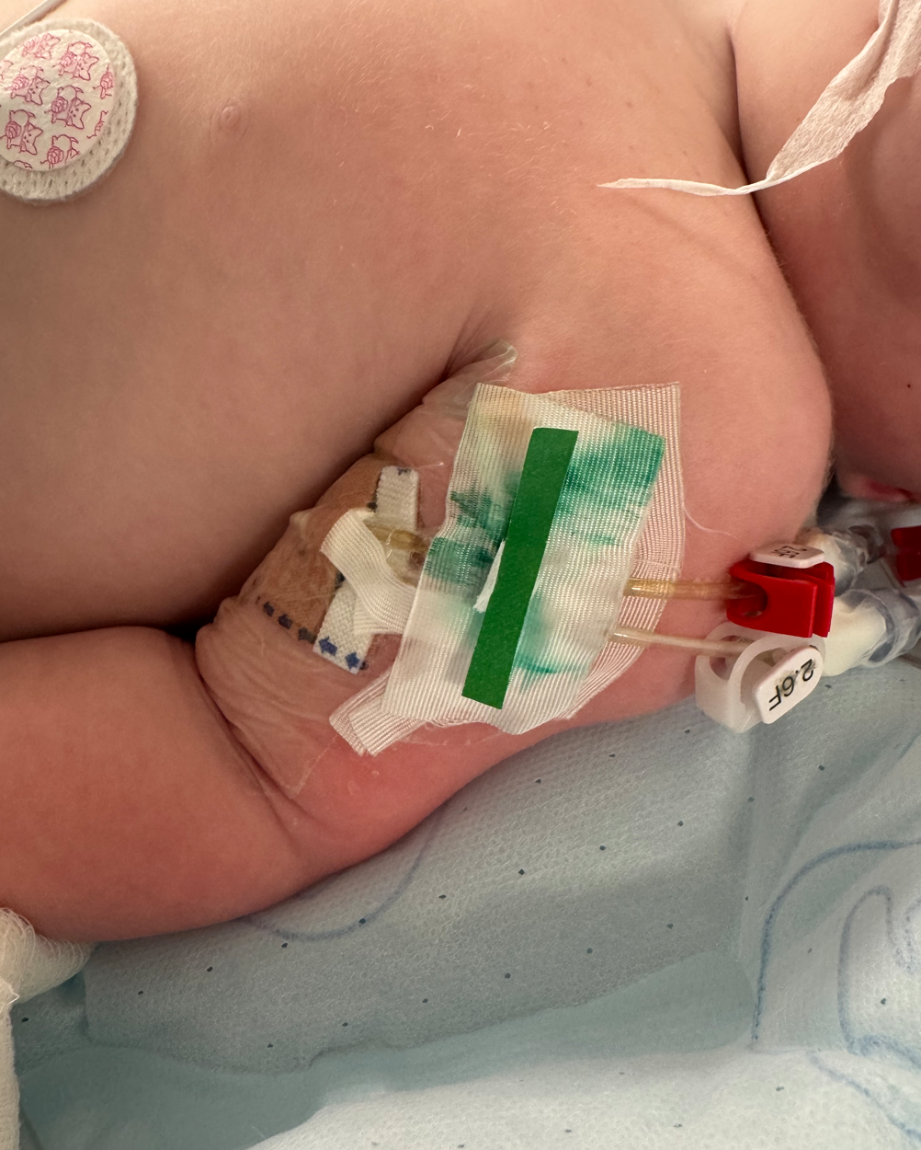
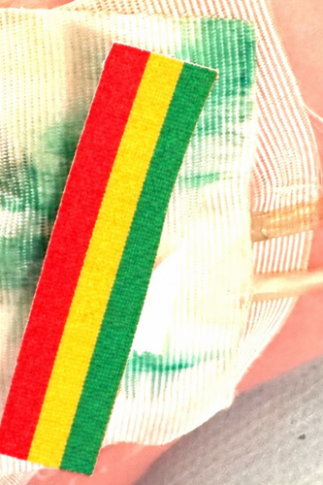
So… How Do We Make it SIMPLE to Know Where a Device TIP is at the Bedside ???
Concept:
Every CCHMC Venous Device HUB has a color label
Defines which Medications (RYG) can be given through each hub
No Need for Bedside Staff to look up EPIC or Radiology reports

Slide 22
Many Operational Questions
Who would place the labels?
How would Labels be available in the Units?
Education
What happenes if a PICC dressing change results in tip change?
We Have Solved More Complex Problems
We Can Do This with a Team Approach…

Slide 23


Cincinnati Children’s Hospital and Medical Center
Vascular Access Team
VAT Total FTE: 47
RN FTE: 38 or 52 RNs
PICC RN FTE: 9 or 12 RNs
VAT Members: Director, Manager, Educator, RNs, PCAs and Child-Life Specialist
Under Peri-Operative Services
Medical Director, IR Attending

Slide 24

Thank You…Questions?

